Slide 1
Malaria Vaccine Project
Multi Club
and
District 9640

Slide 2
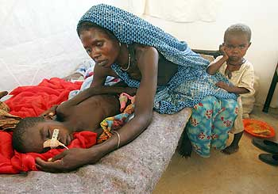
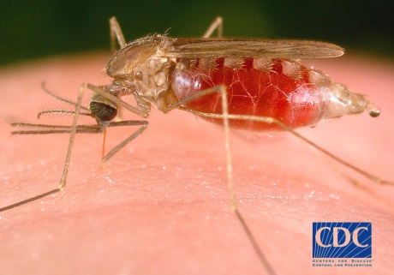
What is malaria?
- A life-threatening infectious
disease
-Transmitted through the bite of an infected female Anopheles mosquito: Plasmodium parasite
-Eight different malaria parasite species can infect humans. Plasmodium falciparum is the most deadly

Slide 3
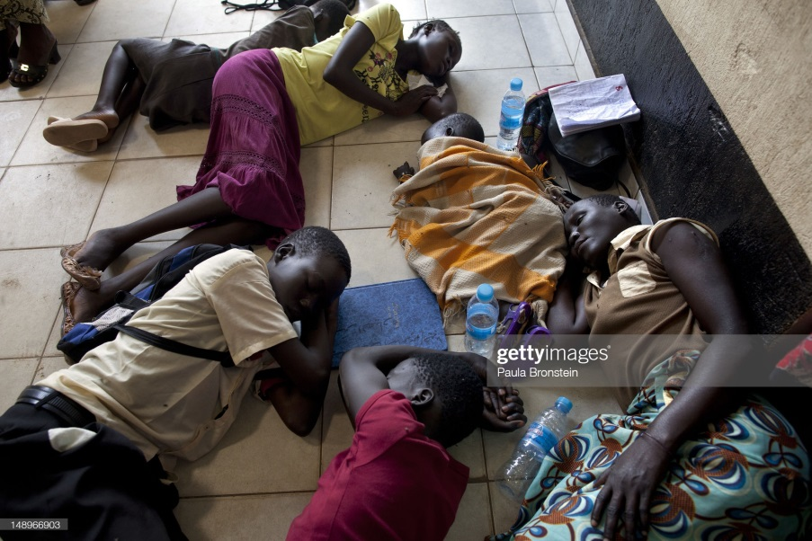
SYMPTOMS
Fever
Fatigue,
Nausea
Coma
Liver, Kidney, Spleen, Placenta
Brain
Death

Slide 4
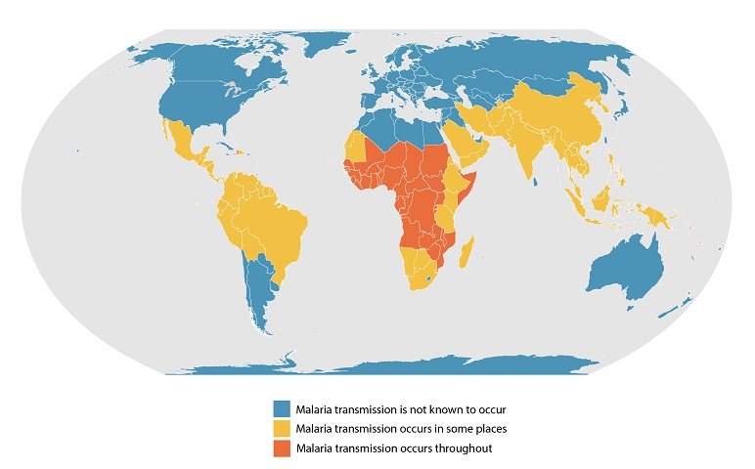
WHERE IS MALARIA?

Slide 5
WHY DO WE NEED A VACCINE?
WHO [2022]
- 619 deaths mostly children under five
and pregnant women
- 247 million cases worldwide
13.3 million pregnancies exposed to malaria. Resulted in 961,00 children with low birth weight
“Need for a vaccine is critical” [WHO)
MOSQUIRIX

Slide 6
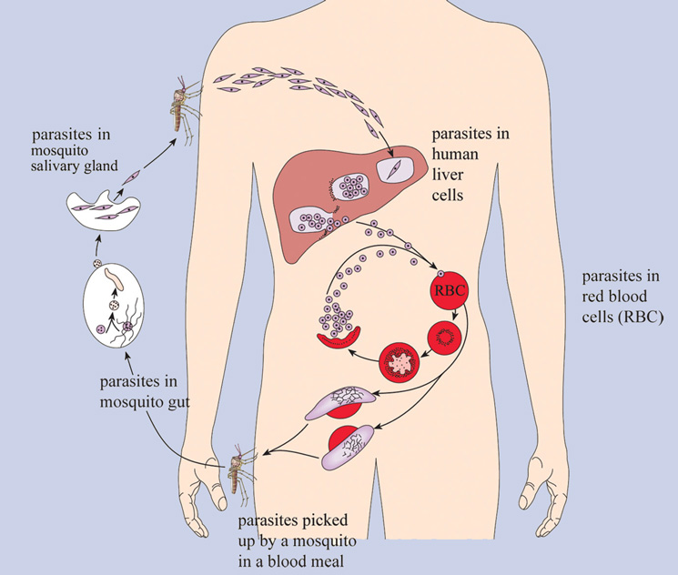
Sub-unit vaccine
VACCINES
Whole Parasite Vaccine
-all parasite proteins ~5,000
-includes those that are the same between parasite strains
individual proteins
can vary between different
parasite strains

Slide 7
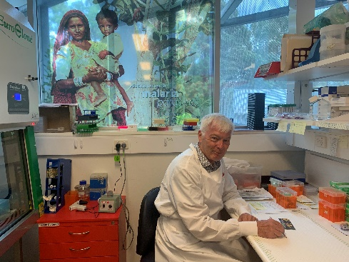
PlasProtecT®: THE WAY FORWARD
What is PlasProtecT®?
Multi-strain, whole parasite vaccine,
chemically-treated in a human red
blood cell
Why we expected PlasProtecT® to work!
Pre-clinical animal studies excellent– prolonged immunity
Phase 1(a) Human Study: safety & activation of immune system strong

Slide 8
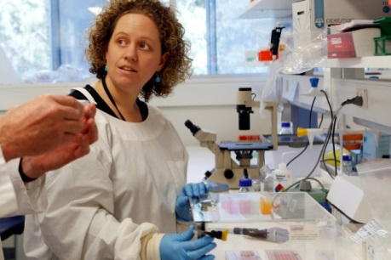
ROTARY AIDS RESEARCH
Gold Coast Phase 2 (a) Clinical EfficacyTrials
Located Gold Coast volunteers
The trials showed that the vaccine [housed in a human blood cell] will protect against malaria? (December 2019)
Professor Good: The trials went very well: the first time multiple subjects have been protected by a whole parasite vaccine

Slide 9
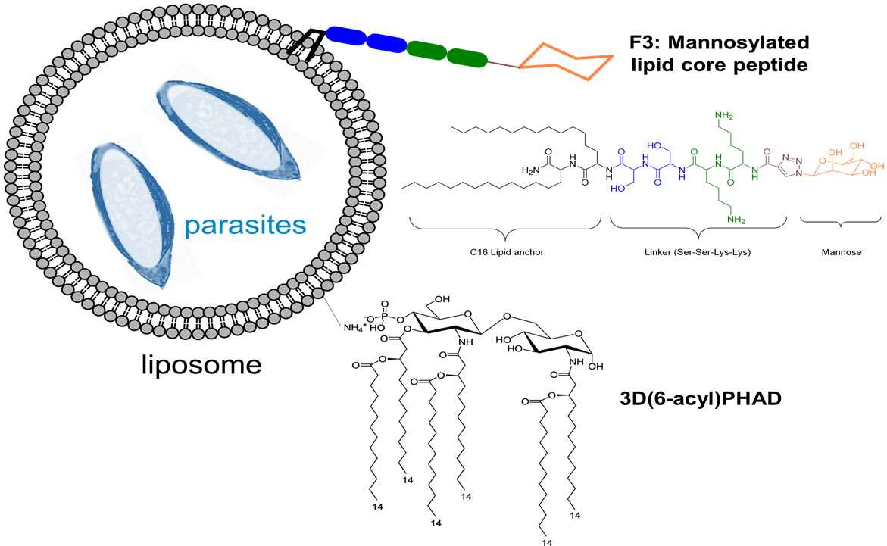
FIELD-DEPLOYABLE FORM
The vaccine is difficult to preserve and store. Moved to the “Lipid” form of the vaccine that can be freeze-dried & stored
Retest the lipid form: animal studies [2021]
External Toxicity Assessment [2022]

Slide 10
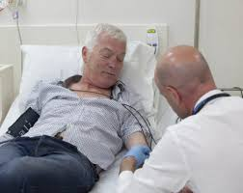
PHASE 1(b) TRIALS 2023
Human trial to test that the vaccine is
Safe
Activates the immune system [n=40]
This trial will be a platform for Phase 2 (b) efficacy trials possibly in an endemic country

Slide 11
OTHER MALARIA VACCINES: Dr Stephen Hoffman [Sanaria, USA]
Attenuated whole parasite vaccine
50-70% efficacy in Phase 2 trials
Planning for Phase 3 trials in Africa & Europe
Large scale administration is problematic (intravenous)
Cooperative venture

Slide 12
OTHER MALARIA VACCINES: Professor Adrian Hill [Oxford, UK]
Sub-unit vaccine, protein-based
78% efficacy in Phase 2 trials with 450 children in Burkina Faso
Planning Phase 3 trials in India

Slide 13
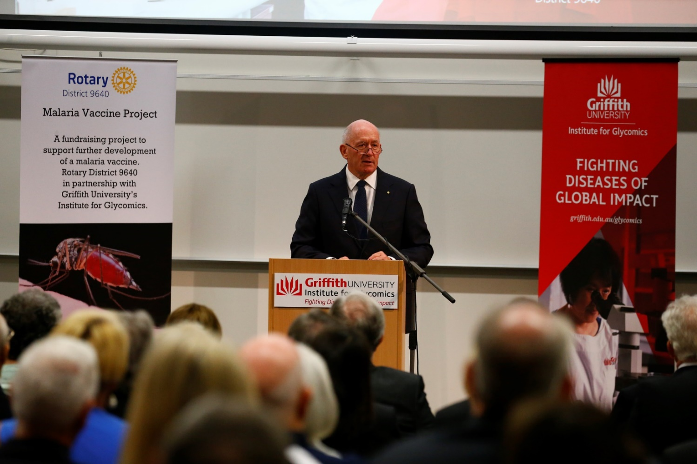
GOVERNOR GENERAL LAUNCH
27 March 2017

Slide 14
FUNDING PROGRESS
How is the Malaria Vaccine Project going?
Target: $3,000,000
Launch Day: $50,000
- Feb 2023: $2,450,000

Slide 15
ROTARY LED THE WAY
8.5

Slide 16
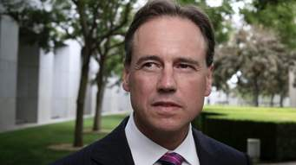
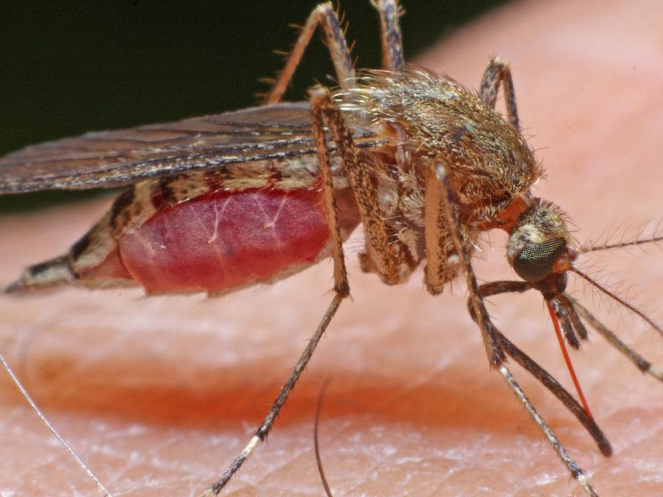
FEDERAL GOVERNMENT MATCH [2019]
$500,000
Health Minister Greg Hunt
Herald Sun (MEL)
How Rotary sausage sizzles are
helping the fight to end malaria

Slide 17
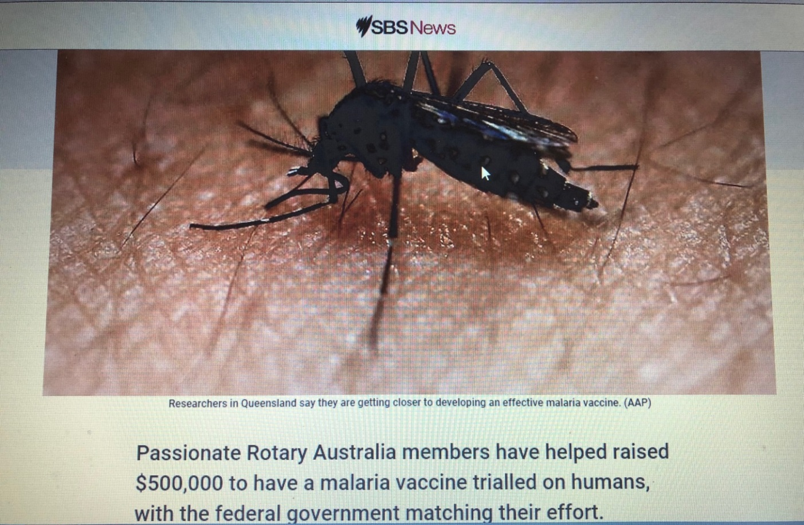
GREAT MEDIA COVERAGE

Slide 18
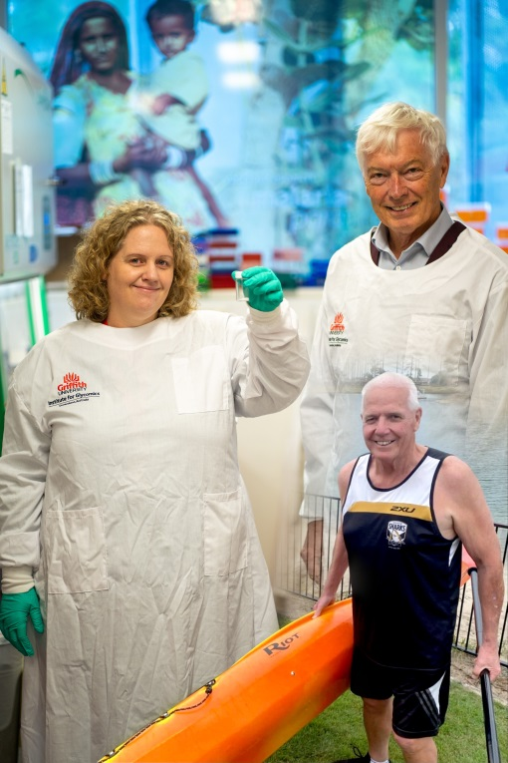
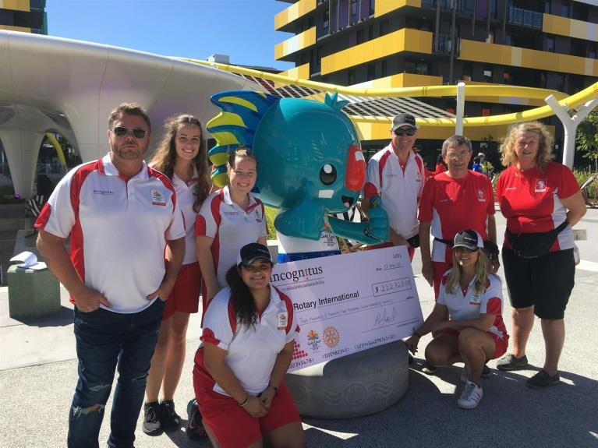
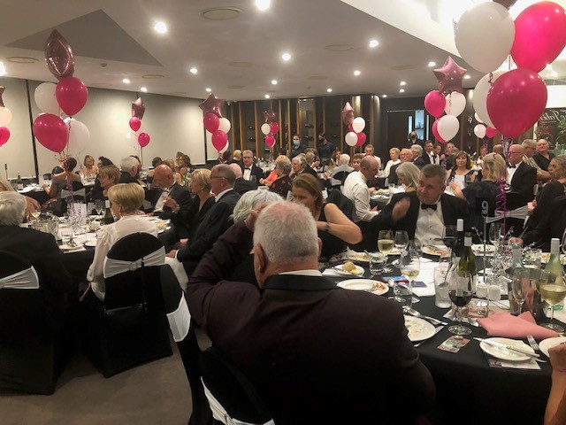
FUNDRAISERS

Slide 19
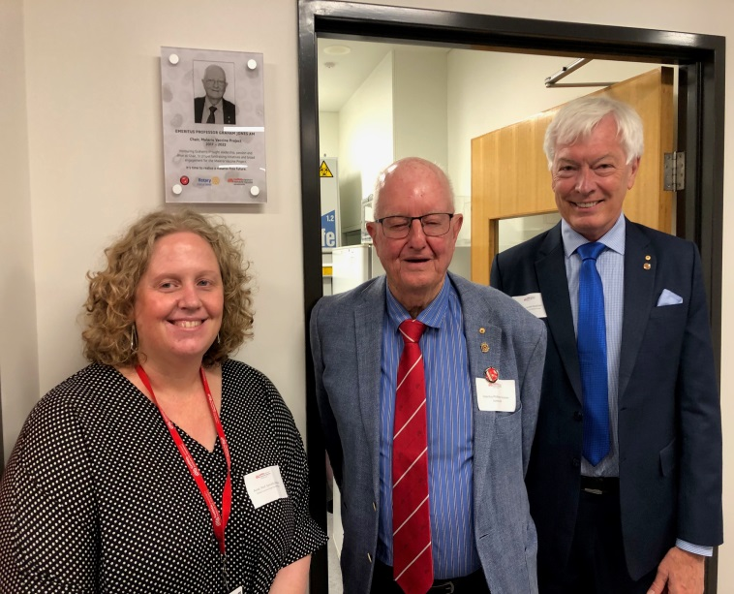
GLOBAL GRANT: Postdoctoral Fellow
Global Grant: GG # 2342550
Host Sponsor: Rotary District 9640
International Sponsor: Rotary Club
of Key Biscayne (District 6990)
Two-year Postdoctoral Scholarship. The Global Grant will bring in AUD $140,000 and that will be fully matched by Griffith University

Slide 20
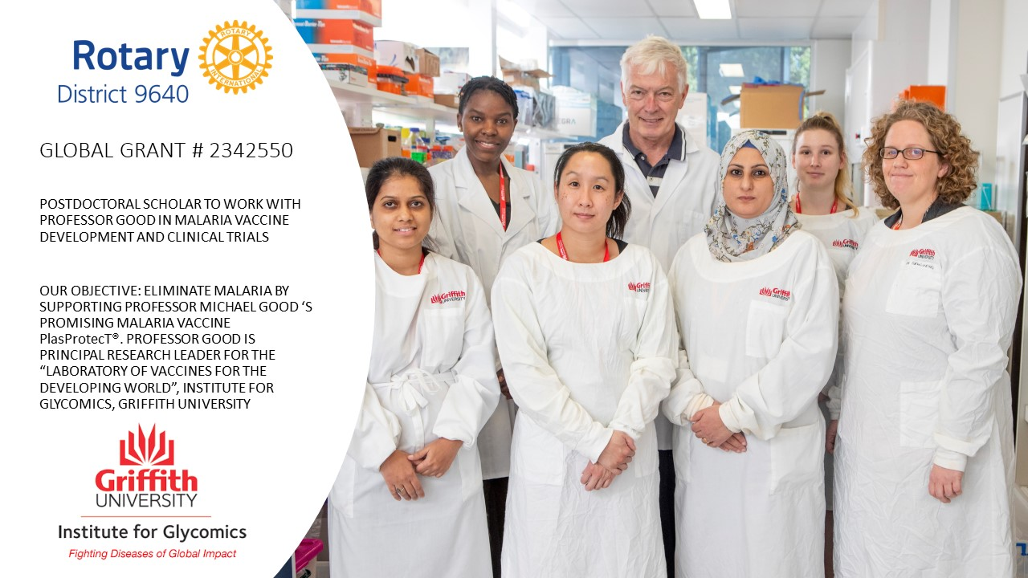
GLOBAL GRANT: Postdoctoral Fellow

Slide 21
GLOBAL GRANT: Budget & Funding
Budget: AUD $140,000.00
Funding [March 2023]:
DDF + TRF Matching: AUD $ 34,866
Cash/Donations: AUD $ 52,492.63
Total: AUD $ 87,358.63 [63%]

Slide 22
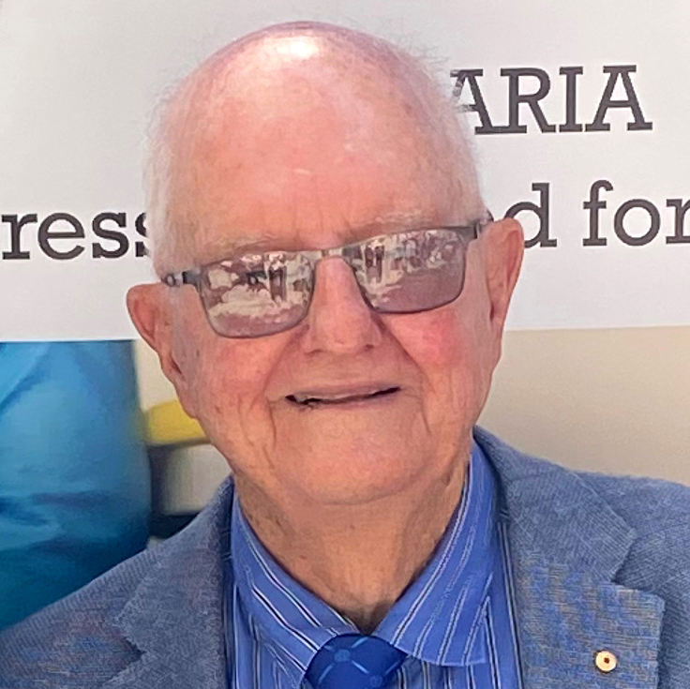
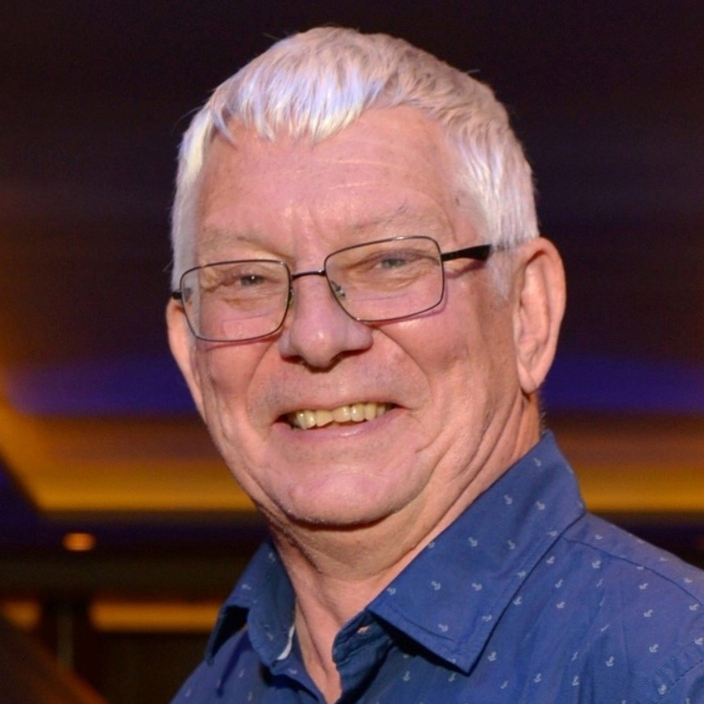
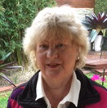
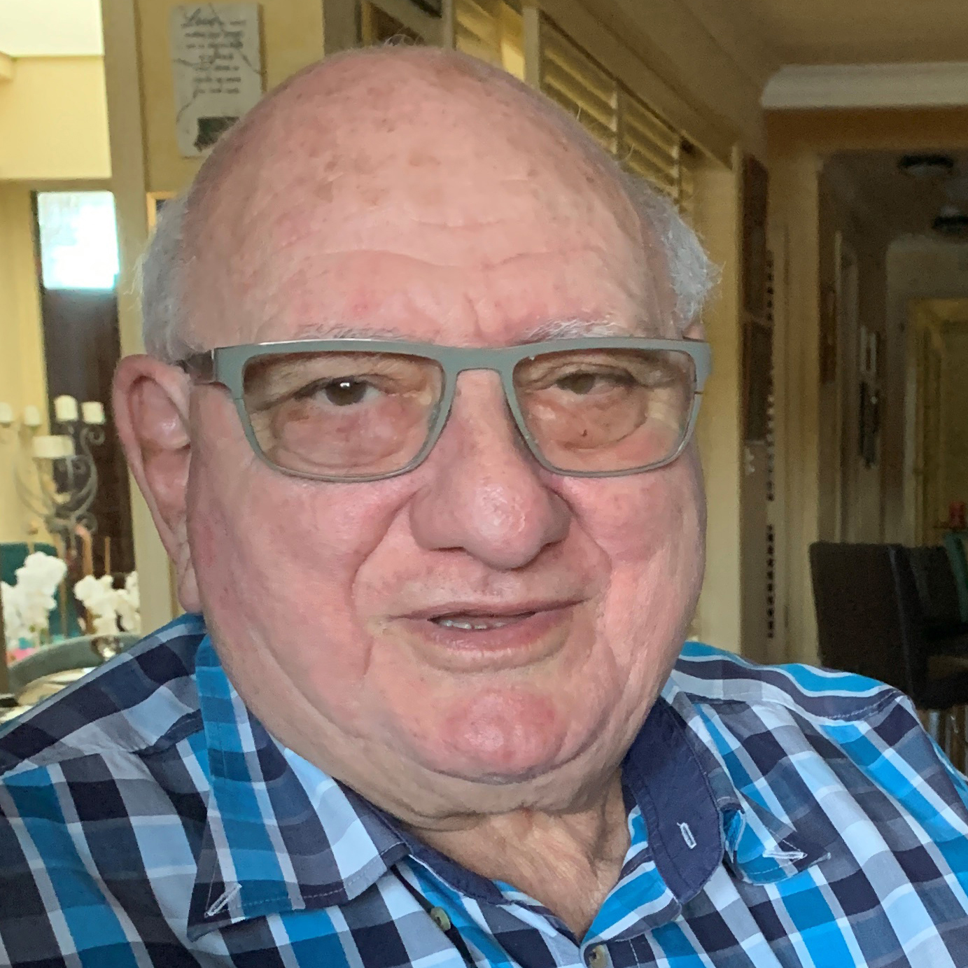
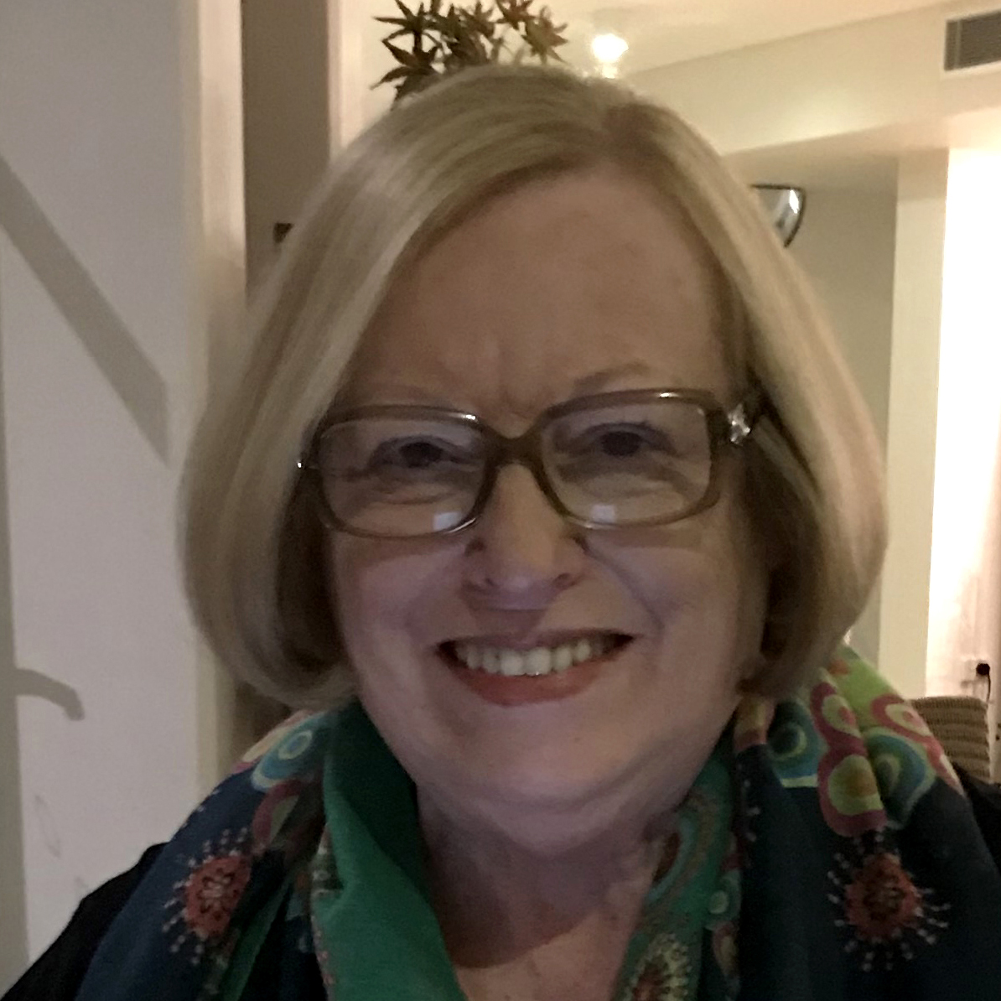
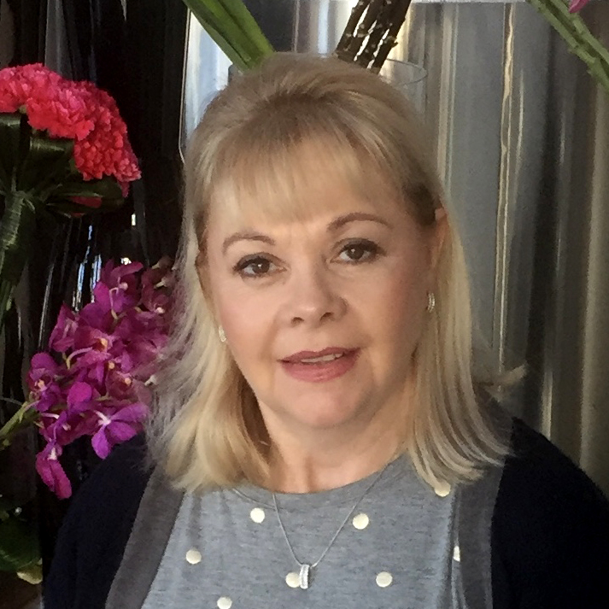
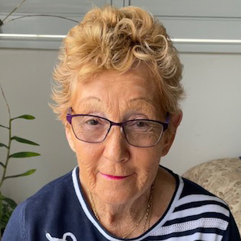
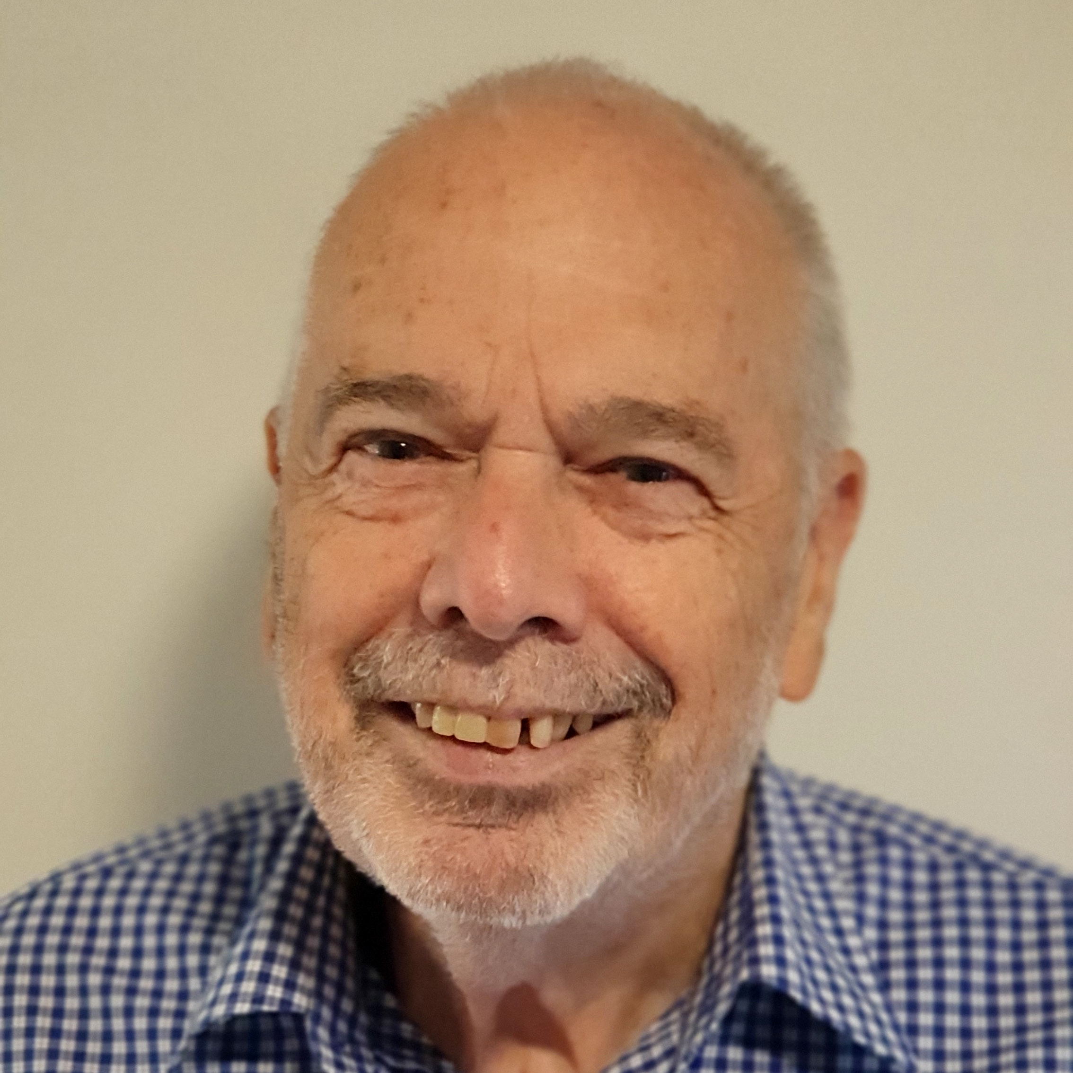
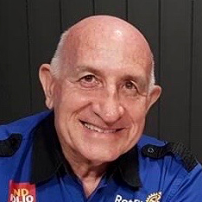
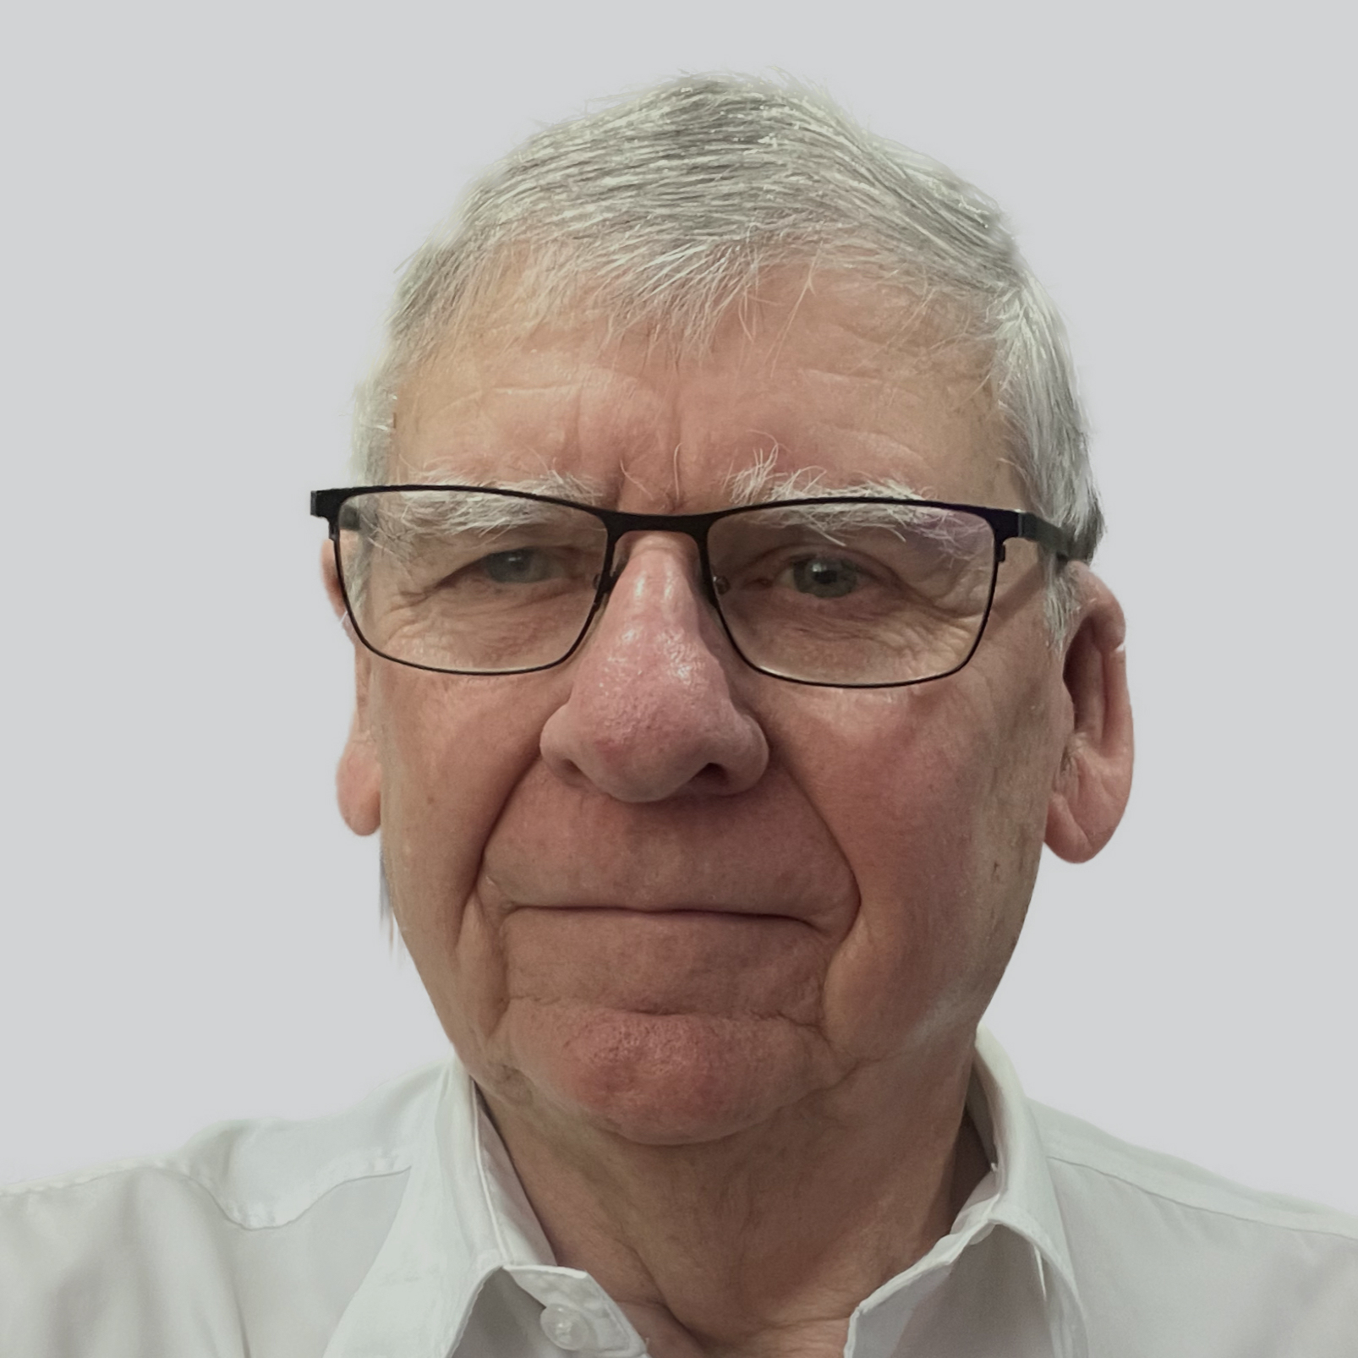
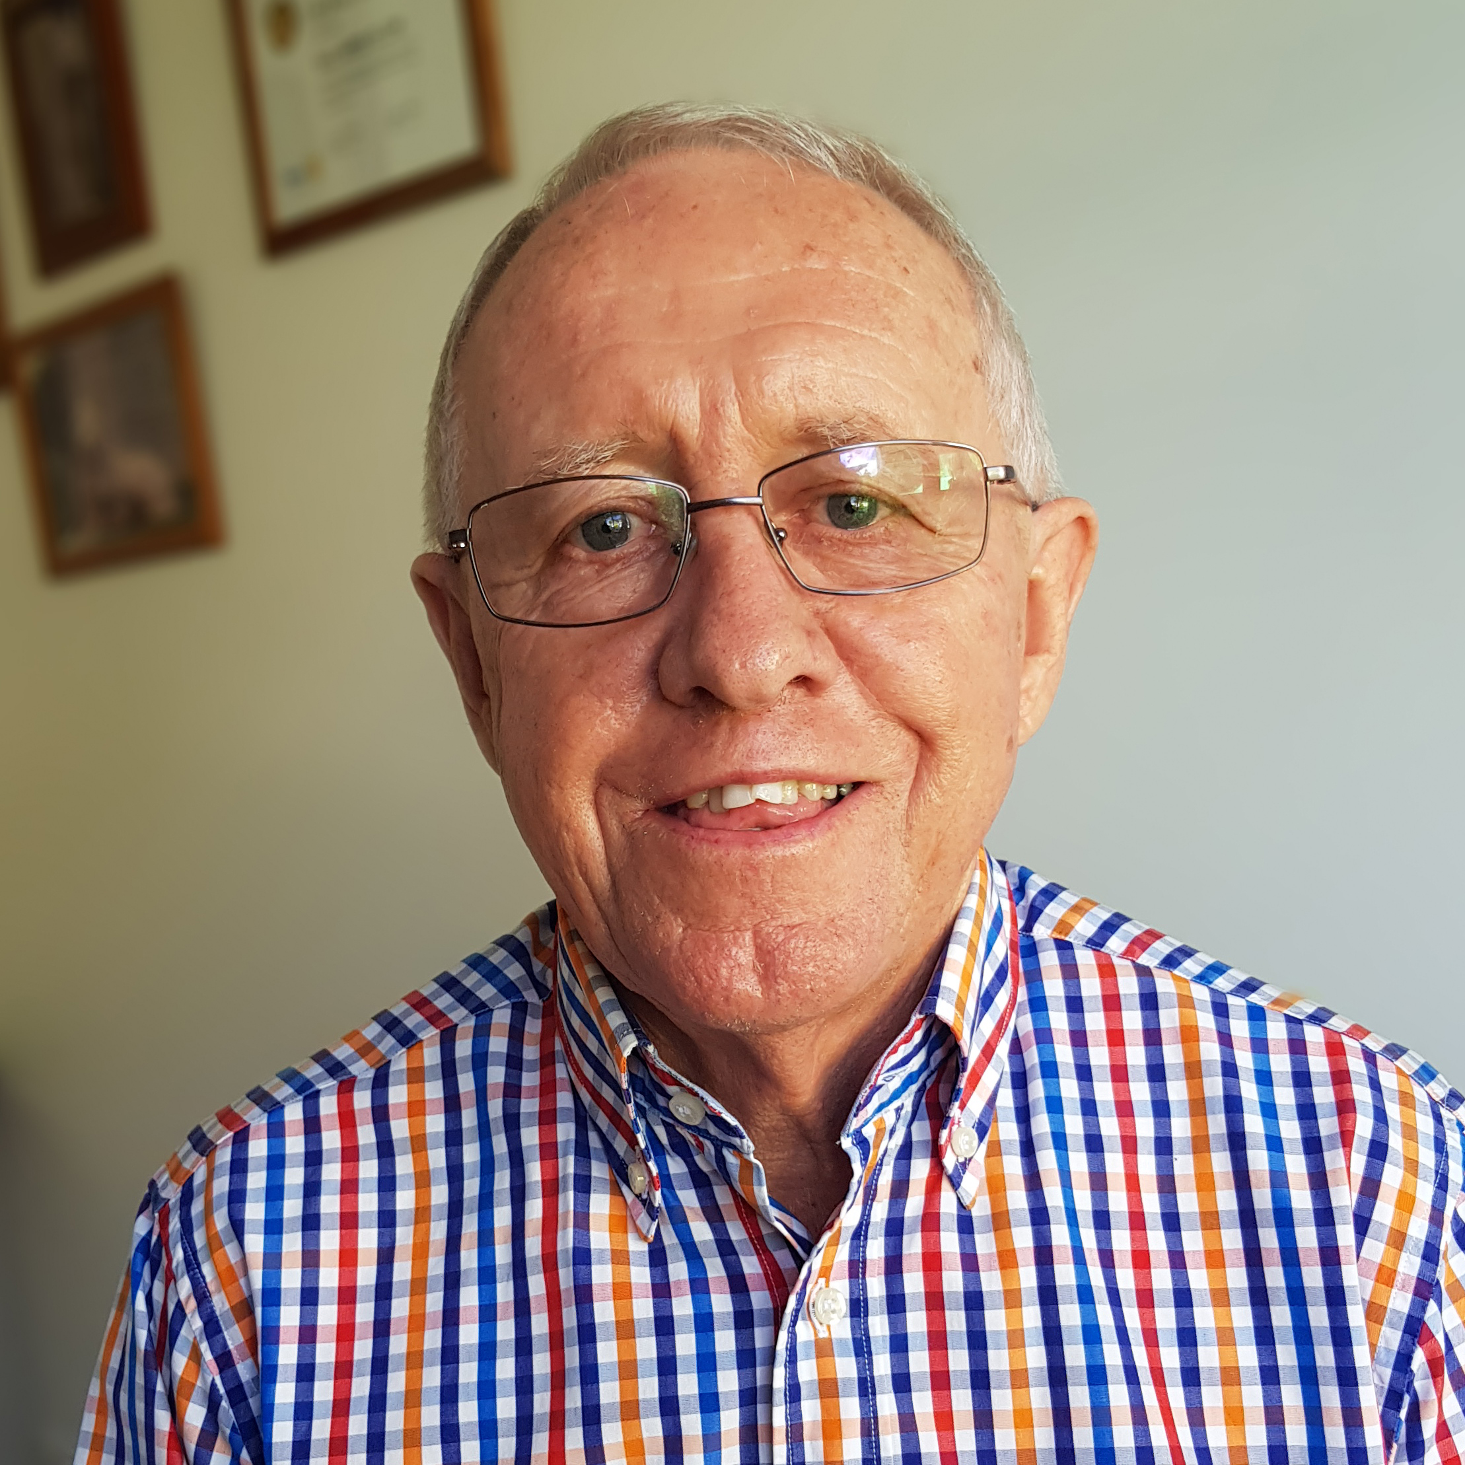
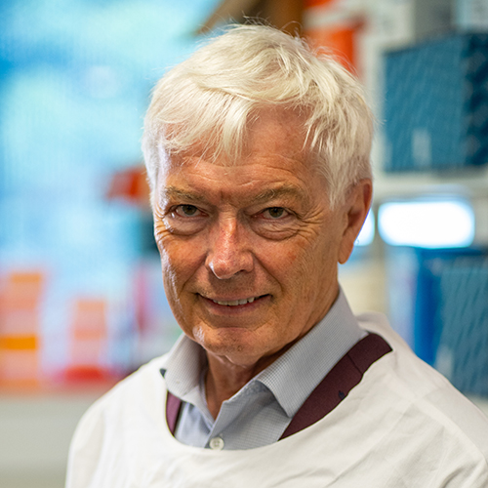
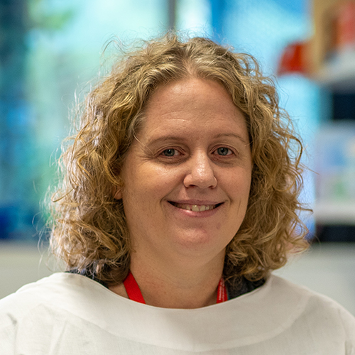
POWER OF 15 WITH THE HORSEPOWER OF ROTARY
PDG Graham Jones AM
Neil Jones
Laraine Brennan
Gerard Brennan OAM
Hon Sam Doumany AM
PDG Sandy Doumany OAM
Teresa Dawson
Karin Kolenko
Mervyn Powell
PDG Ross Smith
PDG Dai Mason
Bruce Howlett
Prof Michael Good AO
Dr Danielle Stanisic
Nina Kristensen

Slide 23
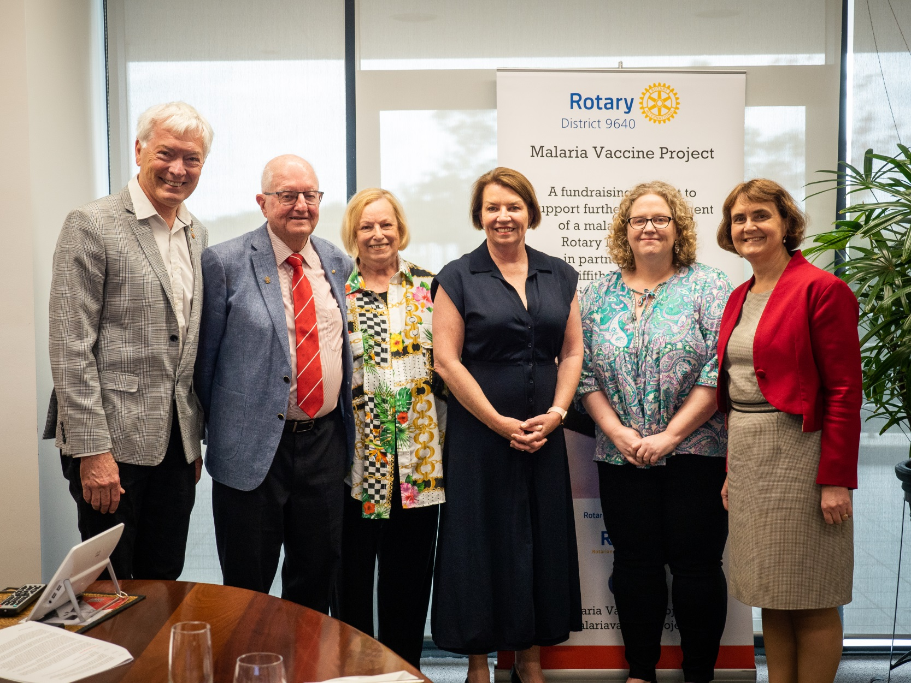
0UR NATIONAL AMBASSADOR: MS ANNA BLIGH AC

Slide 24
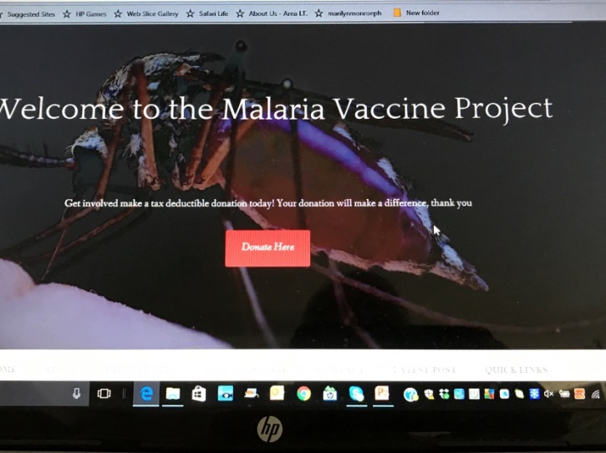
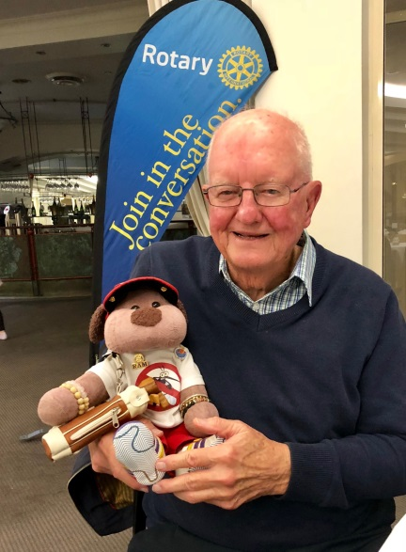
HOW CAN YOU HELP
Visit
our
website
GO BENJI !
GOOGLE:
malariavaccineproject.com

Slide 25
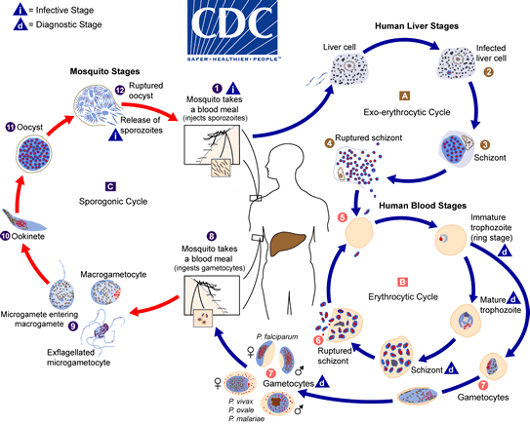
MALARIA LIFE CYCLE

