Slide 1
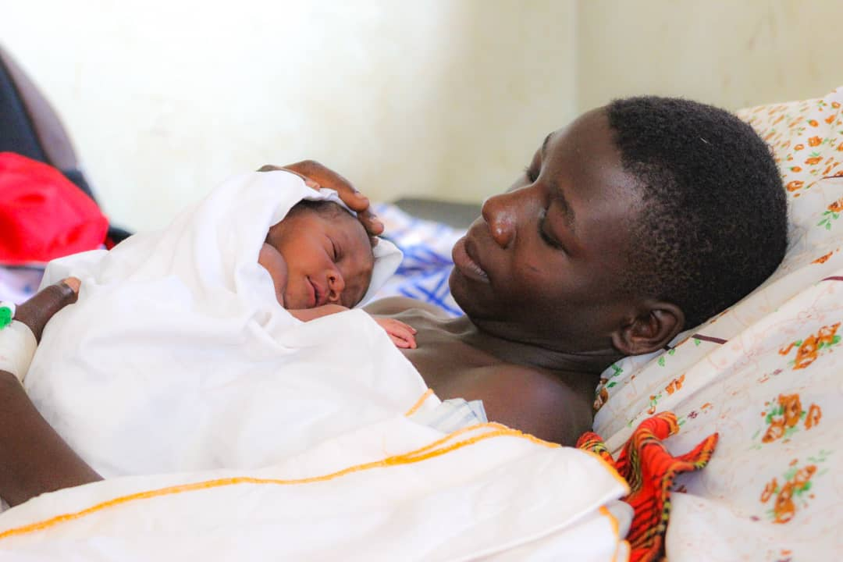
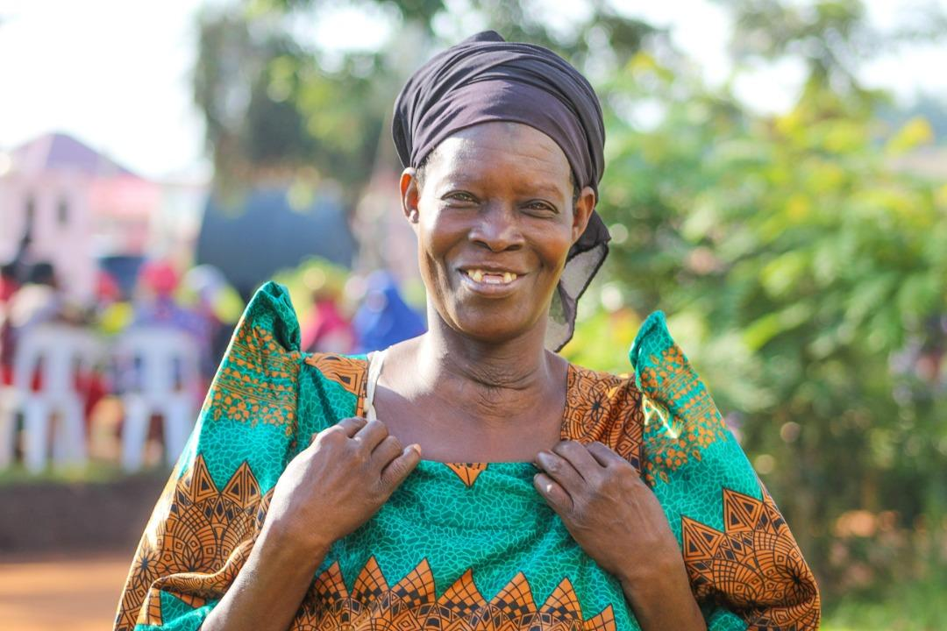
Transforming
Healthcare in Africa
October 28, 2022
Bulamu is a 501(c)3 non-profit organization. All stories shared with permission.

Slide 2
Personal Background:
Grew up in Chicago, college in NY, then joined Peace Corps in 2004.
2004-2007: Peace Corps in Benin, West Africa. Training, teaching English in a village school & organizing health programs. Intro to Rotary!
2010-2017: Rwanda. 2011: co-founded Bridge2Rwanda Scholars. 300+ U.S. university scholarships for East African students so far. One story.
2019: Bulamu Healthcare. We treat patients in rural Uganda & provide systems that improve healthcare for the poor and can scale.
Bulamu Healthcare:
Non-profit founded 2016 by US retired IBM exec and Ugandan nurse.
Pre-Pandemic: Medical Camp model.
Feb. 2020: Treated 17,200 patients in 1 week for $5 per patient.

Slide 3
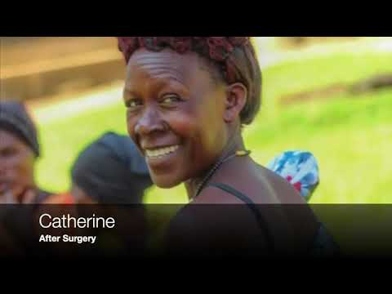
Patients We Serve:

Slide 4
At a Glance:
Videos Patient Profiles Reports & Audits

Slide 5
Pandemic Era: Improving healthcare for the poor.
Bulamu’s Mission: To treat the sick and strengthen health systems serving Africans most in need.
Budget = $1.6 million in 2022.
We do 2 things to improve healthcare in Uganda:
1. Treat Patients Directly - We organize teams of local doctors, nurses and midwives. Then fund, equip & support them.
2. Low-Cost, High-Impact Health Systems - We design & provide common sense systems to 260+ partner health facilities that lead to better care for 1+ million patients in 2022.
Goals: Scale nationally in Uganda & share our systems with more countries over time.

Slide 6
Bulamu’s Direct Treatment Programs:
Total (2016 - 2022):
325,034 Ugandan patients treated directly for about $6 per patient
Including 10,000+ surgery patients. Cost = $163 per patient (2021).
2016 - Feb. 2020 (Pre-COVID):
17 week-long medical camps treated 154,690 patients total. Last camp treated 17,206 patients in early 2020. Cost = $5 per patient.
June 2020 - Present:
General medicine and maternity care teams treated 170,000+ patients.
10,502 babies delivered! (880 by C-section.)
All care provided by Ugandan doctors, nurses, midwives & staff.
Surgery Program: 5,000+ surgery patients treated for free since 2020.
76% of surgery patients waited 3+ years for surgeries we provided.

Slide 7
Bulamu’s Health Center Excellence (HCE) Program:
2018 - 2020:
Foundation challenges us to fix systems, not only treat patients directly.
Pilot system installed in 26 public health facilities (202k patients per year).
2018 survey: 59% of patients approve of facilities. Early 2021: 94% approve!
2021-2022:
Today: Health Center Excellence Program installed in & supporting 262 public health facilities. Will pass 300+ partner health facilities by yearend.
Key Systems: Emergency Transport; Essential Surgical Supplies (to ensure C-sections available); Patient Treatment Forms & Equipment (to improve care and increase patient visits); Surgery Program; and Data for Leaders.
Maternal and Child Health Initiative with goal of reducing mortality for mothers’ and newborns.
Our 300+ partner health facilities treat 3+ million patients per year. Annual cost = less than 25 cents per patient.

Slide 8
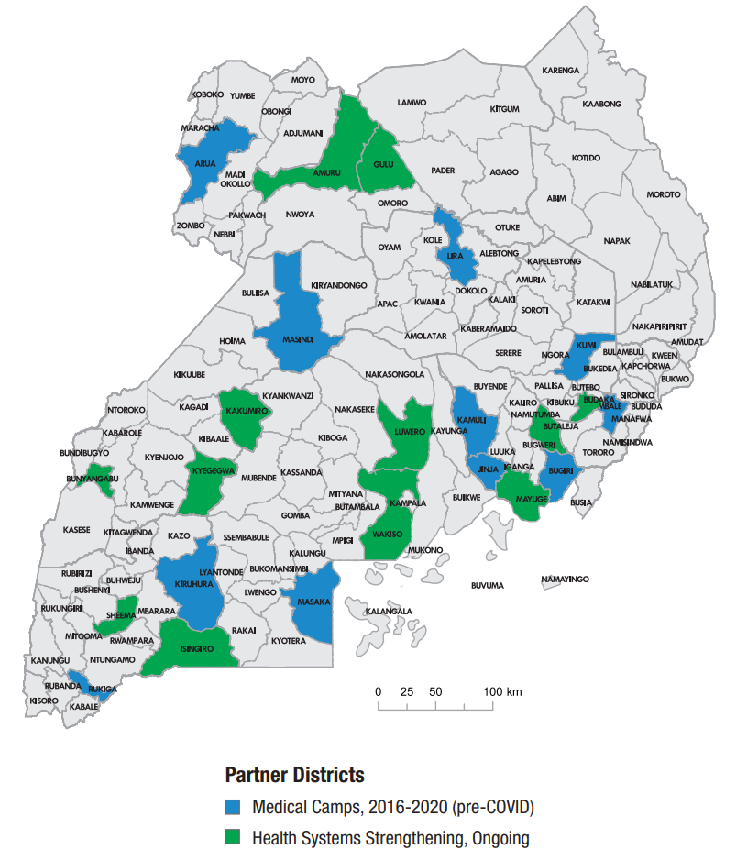
How can we transform healthcare for the poor?
2022 YTD:
39,000+ patients treated directly (general medicine).
6,000+ surgery patients treated & supported.
Bulamu’s Health Center Excellence Program works with 260+ health facilities that treat 2+ million patients per year
Rotary global grant 1 now 90% done: Vital signs devices and training for 125+ health units, treating ~900,000 patients/year. Cost $91,000 (fully funded)
Bulamu’s Partner Districts in Uganda:

Slide 9
New Rotary Global Grant: “Model Districts for Maternal and Child Health in Uganda”
5 systems for better maternity & newborn care:
Rotary will fund: 1) Maternal and Child Health Equipment and 2) Clinical Training for Newborn Care.
Bulamu is funding: 3) Emergency Transport, 4) Essential Surgical Supplies, and 5) Maternity Patient Treatment Forms.
$200k global grant. Led by PDG John Magezi in Uganda, with 5 Ugandan and 5 US clubs so far (Kabarole Ug. and Encinitas CA as lead clubs)
Goals: 1) Support 63 maternity facilities that deliver ~100,000 babies per year. 2) Reduce maternal mortality and neonatal mortality rates.
Prove it works and apply for Programs of Scale ($2 million from RI)
Funds ~60% raised. Need new pledges of $30k-40k to get District and RI matches.

Slide 10
Few NGOs match the cost-effectiveness of Bulamu’s model of mobilizing local resources:
Compare our 2021 results to Mercy Ships, which uses 600-staff hospital ships to bring healthcare to coastal African cities. (Both NGOs provide additional services.)
Performance Metric | Mercy Ships | Bulamu
Total Revenues | $212,689,629 | $1,214,190
Total Expenses | $142,842,150 | $1,336,388
Surgeries Provided Directly | 3,138 | 2,422
Total Expenses / Total Surgeries | $67,779 | $552
Net Assets, Year-End | $232,236,776 | $90,314
Fundraising & Admin Expense % | 32% (2020) | 15% (2021)

Slide 11
A few thoughts so far:
Small efforts can grow and improve. We can do more than we think.
Perseverance over time leads to change. Many problems easier to make progress on than it might seem.
How you can help:
New Rotary global grant: Maternal and Child Health for 100,000+ maternity patients per year in Uganda. $200k global grant (~$40k club level still needed) with US and Ug. clubs/districts.
Then let’s go for Programs of Scale in 2023!
This kind of work needs friend-raisers, fundraisers & everything in between.
Please share with a few friends, send ideas or otherwise help to support.

Slide 12
5 key systems can scale nationally in Uganda for <$5 million per year, serving tens of millions of patients/year:

Slide 13
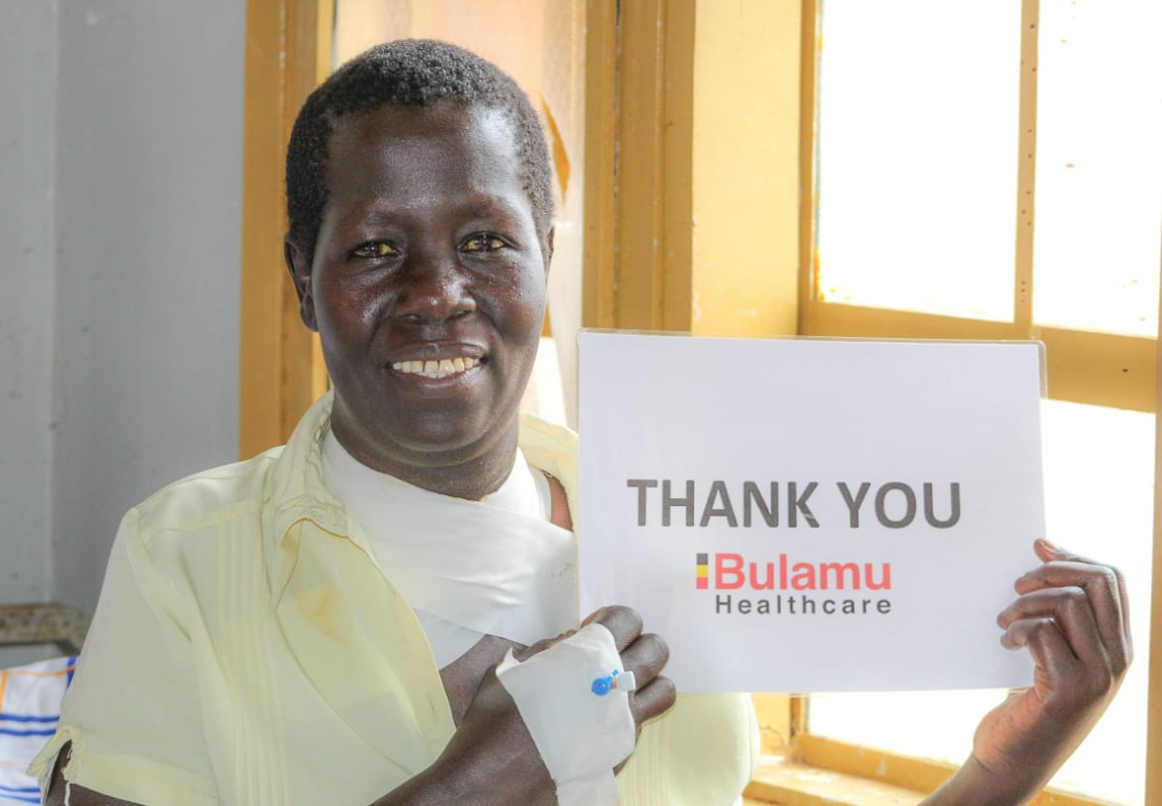
Thank you. Questions, please!
Margaret said, “I will always remember the care and service I received from Bulamu’s team.”

Slide 14
Appendix:

Slide 15
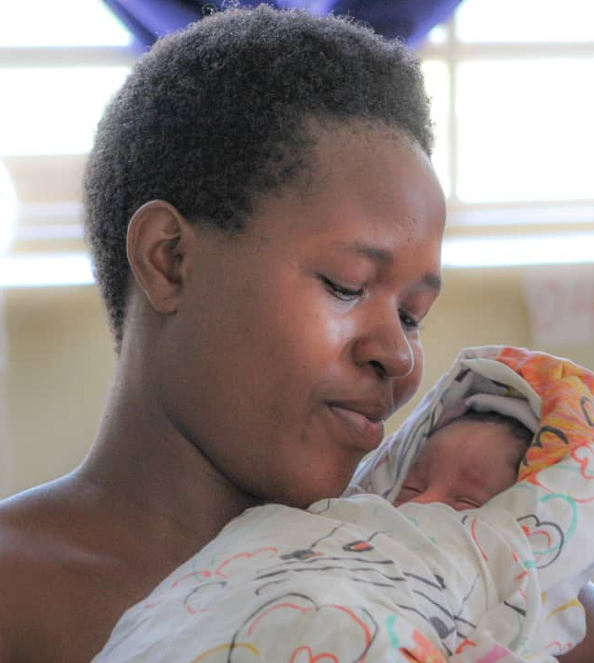
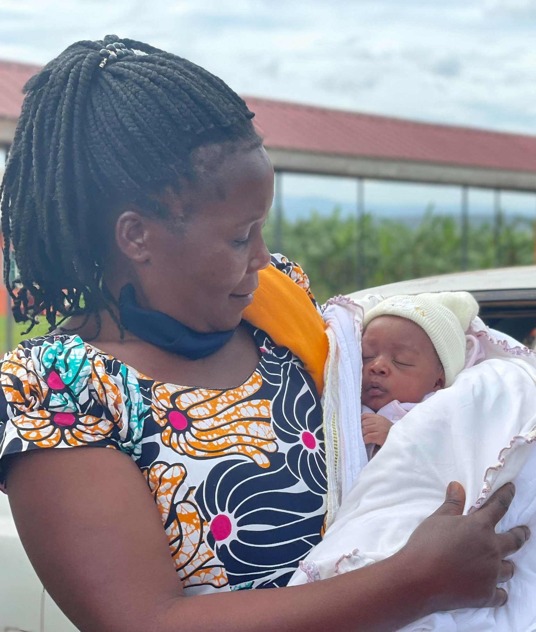
In 2021, thousands of patients needed healthcare. Bulamu’s teams stepped in.
Bulamu’s Clinical Support Teams provided 443 patients with C-sections in 2021.
Rose (top) said of her birth experience: “It was like a dream.” Bulamu’s team delivered and resuscitated the baby after referral from a non-partner facility.
Bottom: One of the first mothers and babies from HC IV operating room we reopened after 11 years out of service.
We also ensure operating rooms at partner HC IVs have Essential Surgical Supplies, to provide C-sections without “down days.”
1 DAY AFTER
4 WEEKS LATER

Slide 16
Bulamu is a demonstration project for Uganda’s national health system that uses HCE management systems, IT solutions, and MOH’s existing staff to deliver improved patient care.
MOH Permanent Secretary Dr. Diana Atwine in 2021 letter to all districts:
“I am, therefore, recommending Bulamu Healthcare very highly to you.”
MOH Director General Dr. Henry Mwebesa letter to Gates Foundation:
“I am writing to support the remarkable work that Bulamu Healthcare is doing with the Ministry of Health system in Uganda. Each time we meet with Bulamu, we are impressed and amazed by the efficiency and effectiveness of their programs. Bulamu's work represents some of the most promising that the Permanent Secretary and I know of for the future of our health system.”
Our public health contacts consider these endorsement letters highly unusual.

Slide 17
Treatment & Systems: Bulamu’s Strategy Since 2020
Phase I: General Medicine — Clinical Support Team program combines patient care with improving facilities. 56k patients treated (2021). Cost = ~$6 per patient.
Phase II: Surgery Programs — Surgery Intensive program organizes monthly care for patients in need. Angel Program refers patients to best hospitals. 5,085 surgery patients treated/supported in 2021. Cost = ~$163 per SI patient.
Phase III: Systemic Change — Health Center Excellence (HCE) Program improves clinical care through comprehensive hospital/clinic management system.
260+ partner health centers. Train the trainer, IT-based program.
At <$0.25 per patient/year, HCE can serve millions at vaccine-level prices.

Slide 18
Phase I. Clinical Support Team (CST) Program in 2021
Teams of 7-8 Bulamu clinicians spend 8 weeks at 2 MOH facilities, treating patients while training local staffs.
2021: 5 districts, 10 teams, 20 partner health centers
Selected Treatment/Services | Total
Patients Treated | 56,028
Emergency Transports | 209
Natural Deliveries | 3,491
C-sections | 443
MCH Services (Antenatal, Postnatal, Family Planning) | 28,329
Vital Signs % | 81.7%
Unfilled Drug Scripts % (Still a major problem) | 40%

Slide 19
Phase II. Surgery Programs
Surgery Intensive. Bulamu 5-day event at HC IV: 50-person surgical teams treat about 250 patients for cost of $163 per patient.
Angel Program. Escalates complex cases to referral hospitals. We arrange and pay for patient’s treatment at $360 per patient.
2021: Partnered with Assoc. of Surgeons of Uganda for all programs.
2021 Results Summary
Program | Explanation | Patients
Surgery Intensives | 8 weeklong SIs in 7 districts | 1,920
Essential Surgical Supplies | Provide surgery supplies for 9 partner HC IVs | 2,636
Clinical Support Teams | Performed C-sections at HC IVs | 502
Angel Program | Refer complex cases to specialty hospitals | 27
All Programs | Total 2021 Surgery Patients | 5,085

Slide 20
Phase III: Health Center Excellence (HCE) Program
Comprehensive Health Unit Management System. Piloted in 2019 in Sheema District. Now installed in 266 health centers in 9 partner districts.
Will reach 300+ health facilities in 12 districts by Q1 2023.
Key Elements:
Equipment Package: Vital signs equipment, PPE, computers, printers.
Patient Records: Treatment forms (5), maternity forms (4). Patient retains copy of treatment forms with test results, diagnosis, doctor instructions.
Clinical Processes: Vital signs, tracking unfilled prescriptions. Training.
Management Reports: Graphs weekly/monthly KPIs - new for Uganda’s MOH.
HCE-IT System: Data warehouse for performance reports, league tables.
Cultural Change: Using data to control absenteeism (“payroll yield”), improve clinician productivity (“patient equivalents”, or PE’s treated).

Slide 21
Health Center Excellence Program Key Results to Date:
Management System | Pre-HCE (2018-20) | Post HCE Installation (2020-21)
Vital Signs | 3% (Adult Blood Pressure) | 55% to 80+% (~25% of adults: high-BP)
Patient Information | Organized by date. Patient keeps in blank notebook (outdated standard of care) | Organized by name. >1 million records created. 100% of patients rated Bulamu forms “good” to “outstanding” (2021)
Management Reports to share systemic data locally | No system to share recent data with local leaders (pan-African or WHO) | 56 KPIs collected and shared weekly/monthly as visual management reports
Patient Satisfaction | 59% (2018 survey) | 94% (2021 survey; see 2020 A.R.)
Doctor Productivity | No system | Measured & can be managed via KPIs
Surgery Patient Wait Times | 76% of surgery patients wait 3+ years for care | 6,000+ total surgery patients treated and supported without delay YTD
Clinician productivity can improve thanks to multiple system improvements.

Slide 22
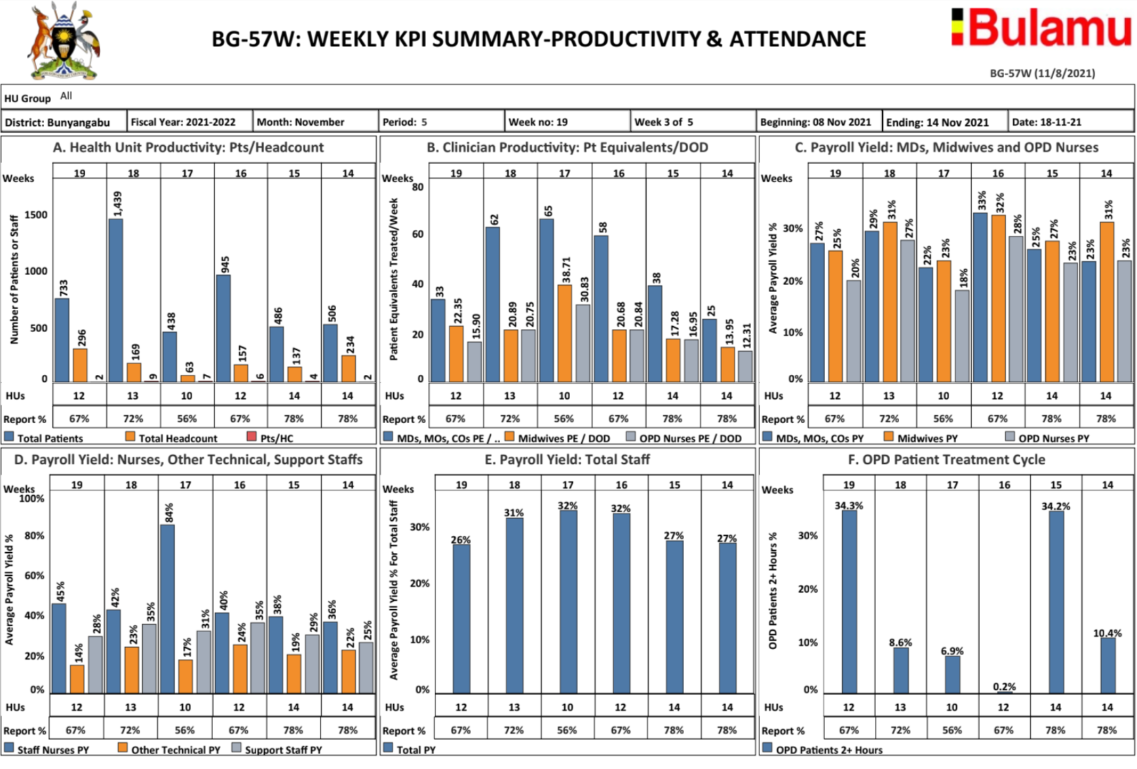
Management Reports Graph Key Performance Indicators and Share Recent Weeks/Months with Local Leaders:
System also graphs Dr. productivity - maybe first in African healthcare

Slide 23
Developments in 2021: New features in Health Systems Strengthening model, new funding partner in Rotary.
Essential Surgical Supplies: Surgery theatres are offline ~50% of time for lack of low-cost supplies (sutures, needles, gloves, etc.) We fill gaps to keep online and understand cost of ensuring C-sections available 100% of time.
Maternal & Child Health (MCH): Launching program to provide 5 maternity patient forms and surgery equipment needed to improve health outcomes.
Essential Medicines & Health Supplies Research: MOH and IRB-approved (TASO and UNCST) project with Makerere U. to assess unfilled prescriptions and supply shortages. Collecting 6 months data at 70 HUs in 20 districts.
Rotary International: $91,500 global grant to support vital signs equipment & training to 125 HUs in 5 districts treating 900,000 patients/year.
Only ~3% of patients have vital signs taken on average. Bulamu’s support moves to 40-80% range.
Standard of Care in U.S. for decades. Equipment cost: $.10/patient in first year.

Slide 24
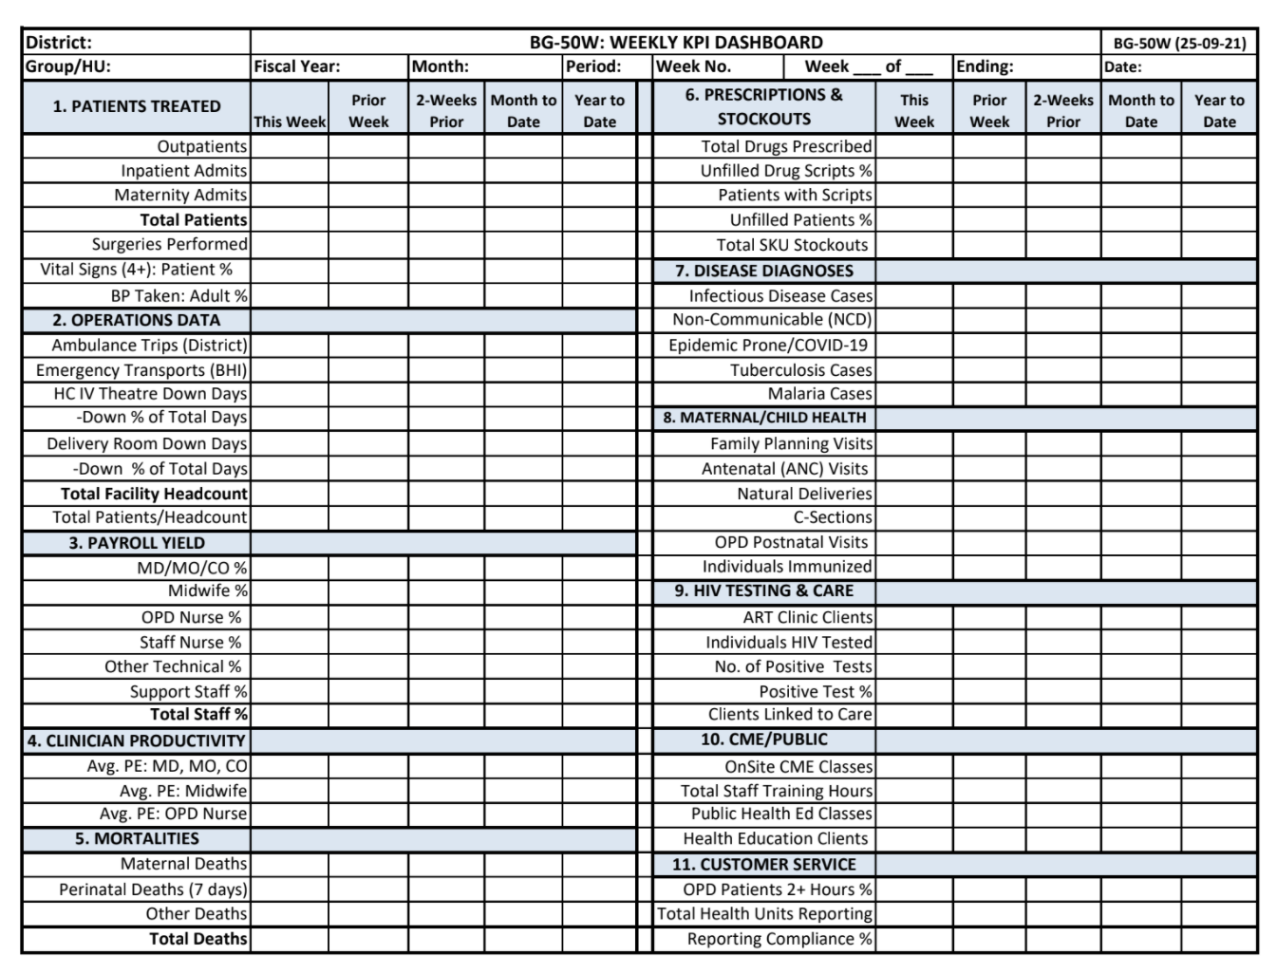
Management Reports’ Weekly/Monthly KPIs:

Slide 25
Conclusion: Bulamu is Strengthening African Healthcare Through Better Management Systems & Data.
Our Strategy CST and SI programs build partnerships with Local District Governments.
Goal Prove and scale HCE Program nationally. Eliminate need for direct programs LT.
Partner and share our work as much as possible Most HCE Program interventions are needed throughout sub-Saharan Africa.
MOH Permanent Secretary Dr. Diana Atwine on the HCE Program:
“How quickly can you extend this to all 3200 Ministry of Health facilities?”

