Slide 1
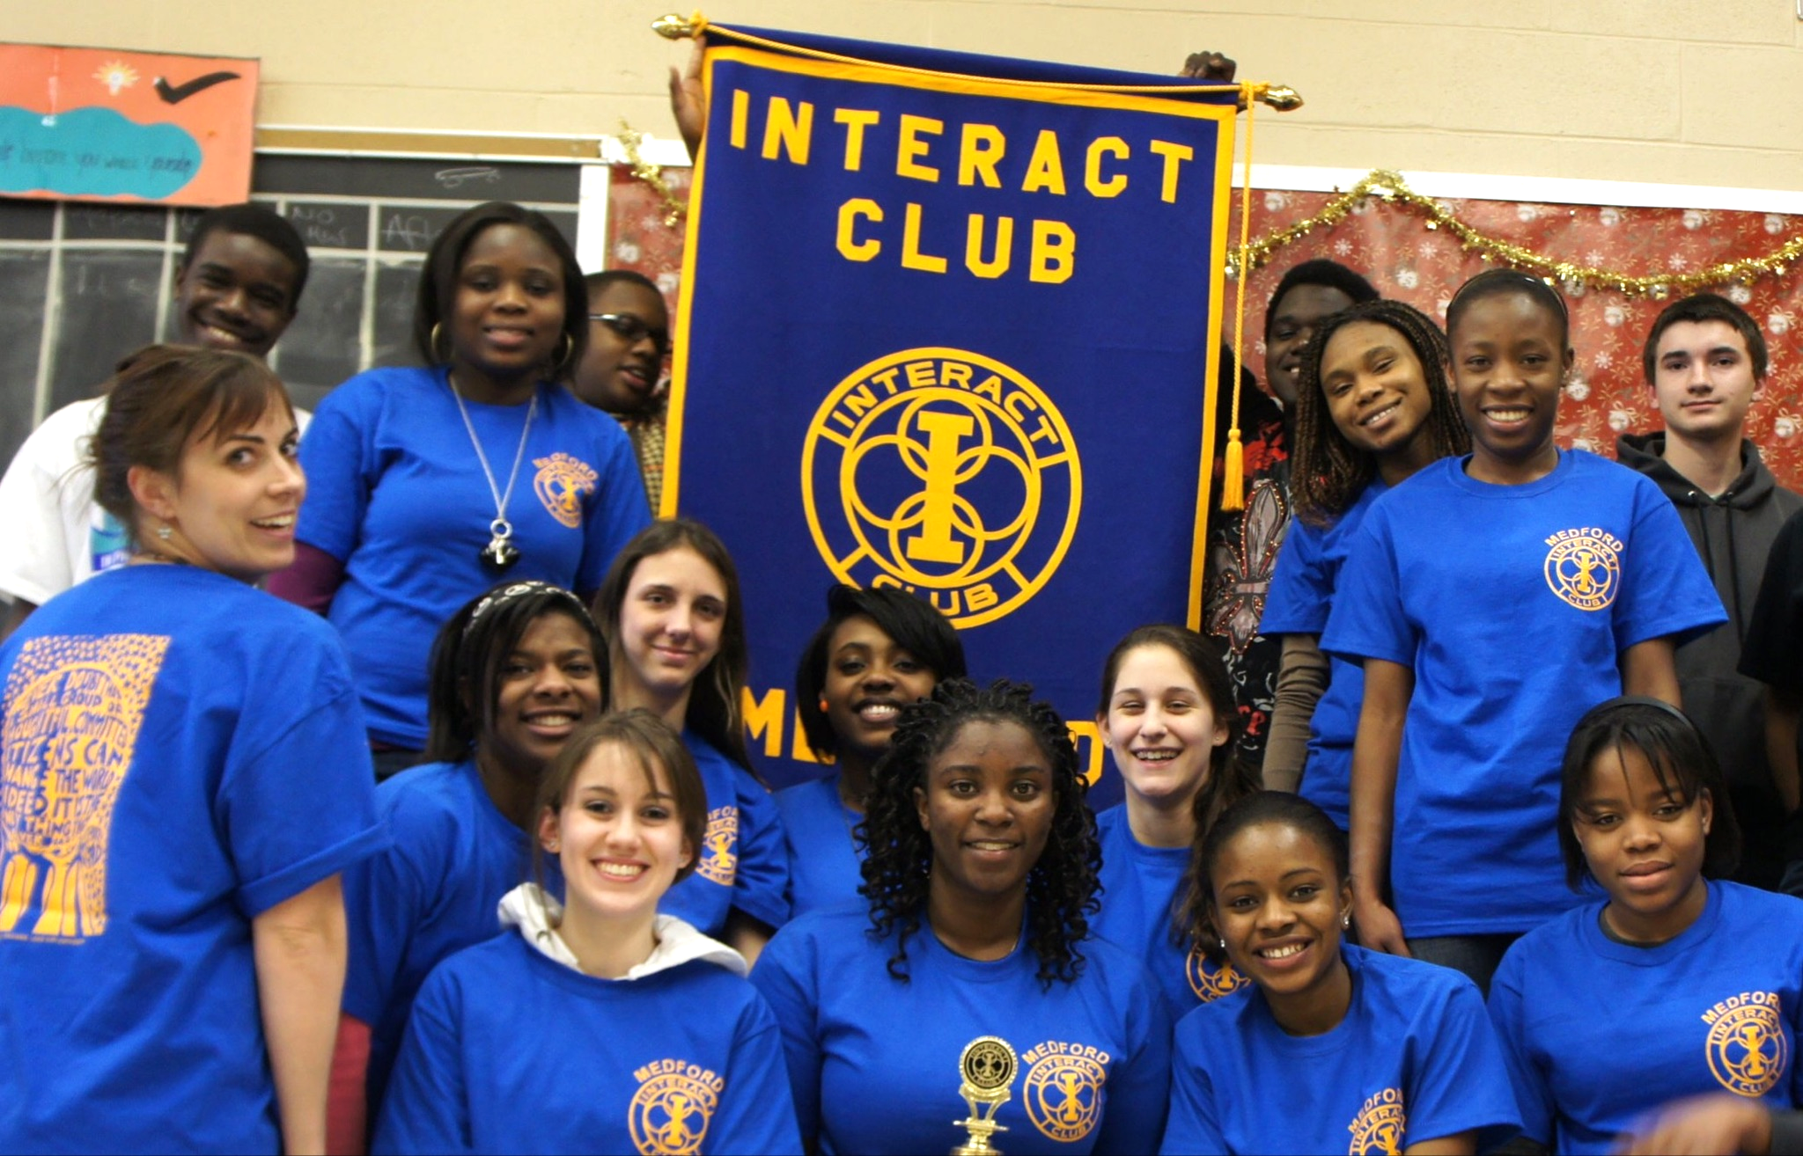
High Schools
Interact Clubs
Youth Service Organizations

Slide 2
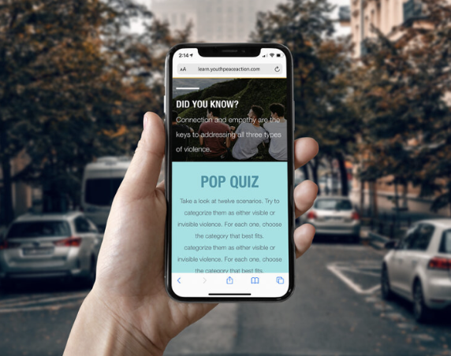
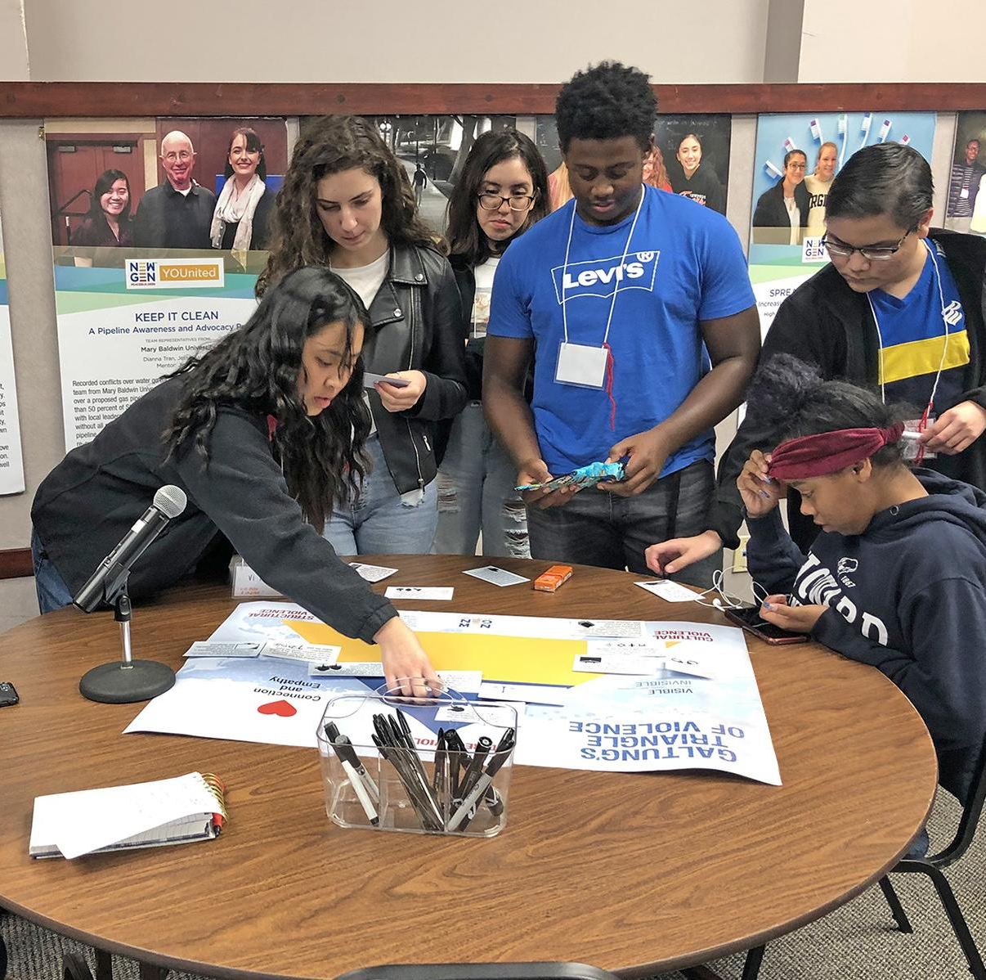
Int’l. Day
of Peace
Virtual Event
Online Peace Platform
Peace Projects in Action
Celebrations
Sept. 21, 2021
Sept. 2021 -
Jan. 2022
Feb. - Apr. 2022
May 2022
The Whole Experience: Balancing Learning and Doing

Slide 3
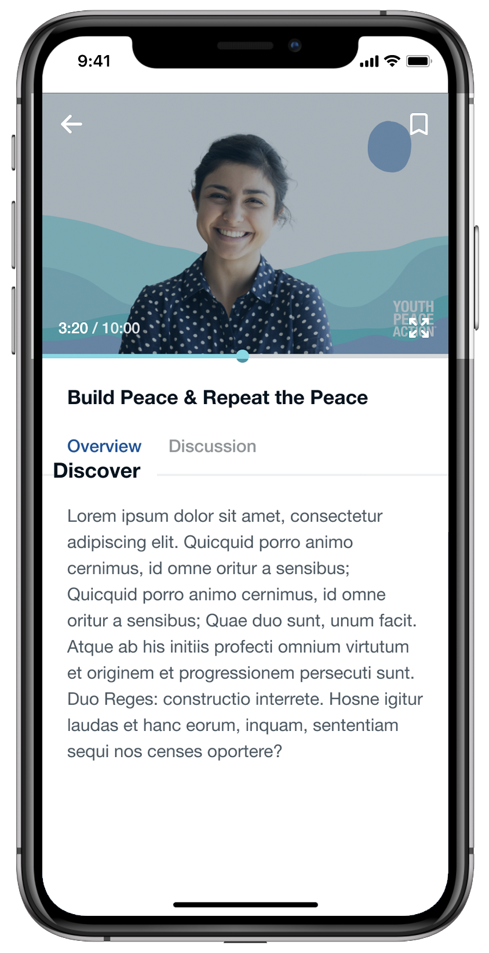
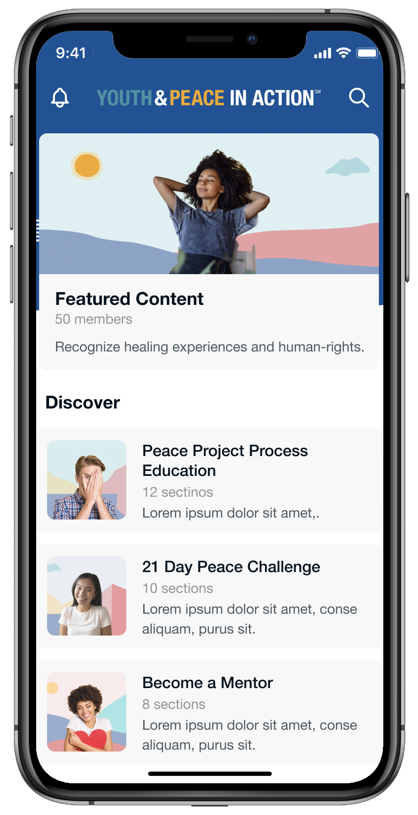
21st Century Learning Management Systems, Mobile-friendly Peace Education Experience
Content, Challenges, Cases, Community
Certificate in 20 Hours of Interactivity!

Slide 4
My Peacebuilder Foundations Certification (Oct. - Dec. 2021)
Objectives
Truly understand drivers of conflict & peace
Imagine innovative solutions to create change
Available to
All students and teachers at participating schools, clubs / orgs.
Participating Rotarians
Modules Focused on 7HSM Framework
Hello & Hope
Harm
Healing
Heart
Head
Hands
Assessment and evaluation after each module and course completion
Notes:
Add student will be evaluated at the completion of each module to assure mastery of the course content either at truly understand/or at the 20 hours of online content student mastery is evaluated
Under overall objectives
Drivers of conflict and peace, learn how to use data to analysis violence/conflict/harm/problems in their communities(critical thinking skill to solve problems)

Slide 5
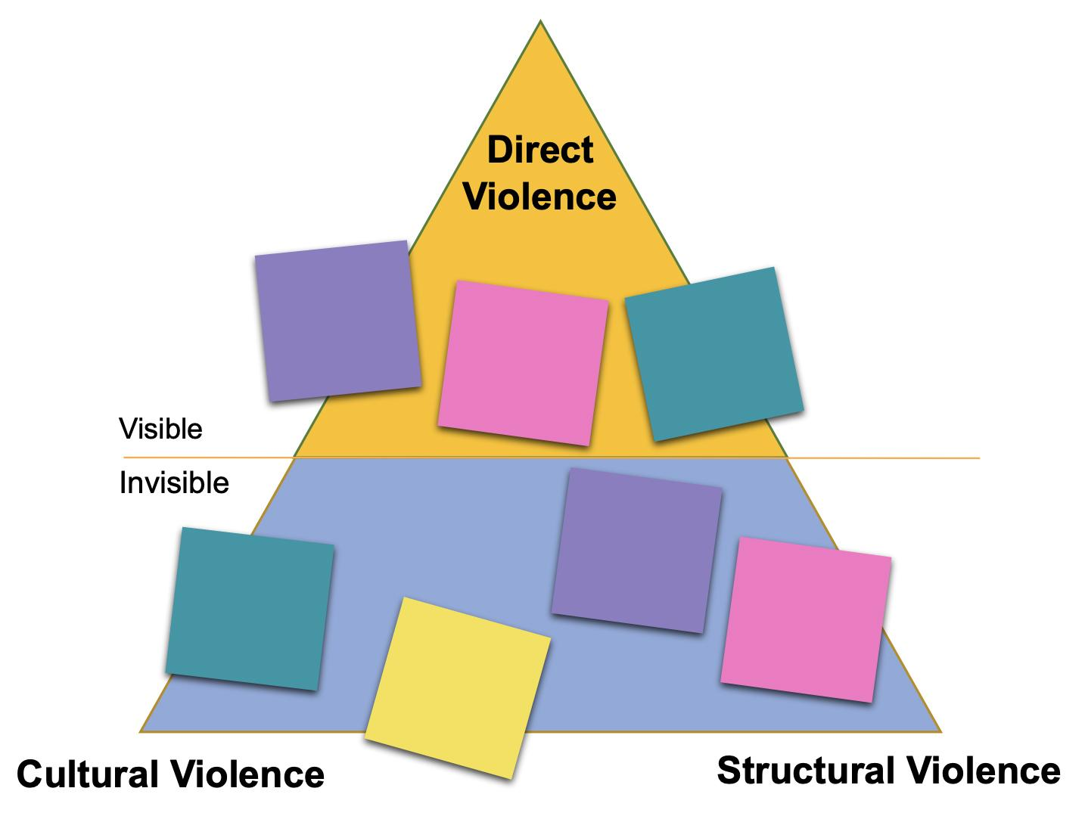
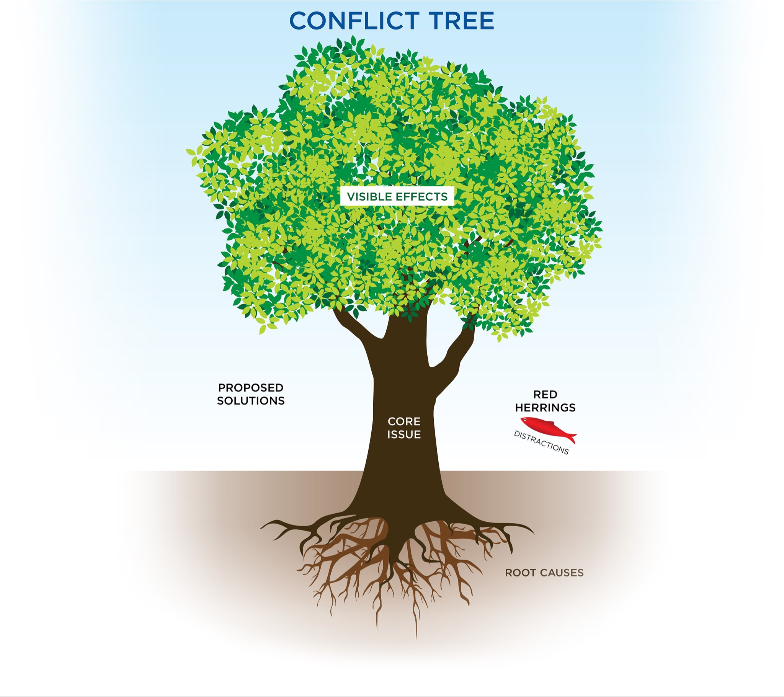
Established Peace Frameworks
Knowing
1
2

Slide 6
Peace Projects in Action Certification (Feb. - Apr. 2022)
Test, Design,
Implement
Training
Present Results
Select student leaders and mentors trained to lead peace project teams: 3 hours online; 10 hours live virtual/in-person
Using problem statement and project idea - teams test idea, prototype, implement project
Peace project results learning shared via a “Pecha Kucha” style presentation
One representative applies for a small
group of people who will lead a larger project team
Each team paired with a trained Rotarian or other adult mentor

Slide 7
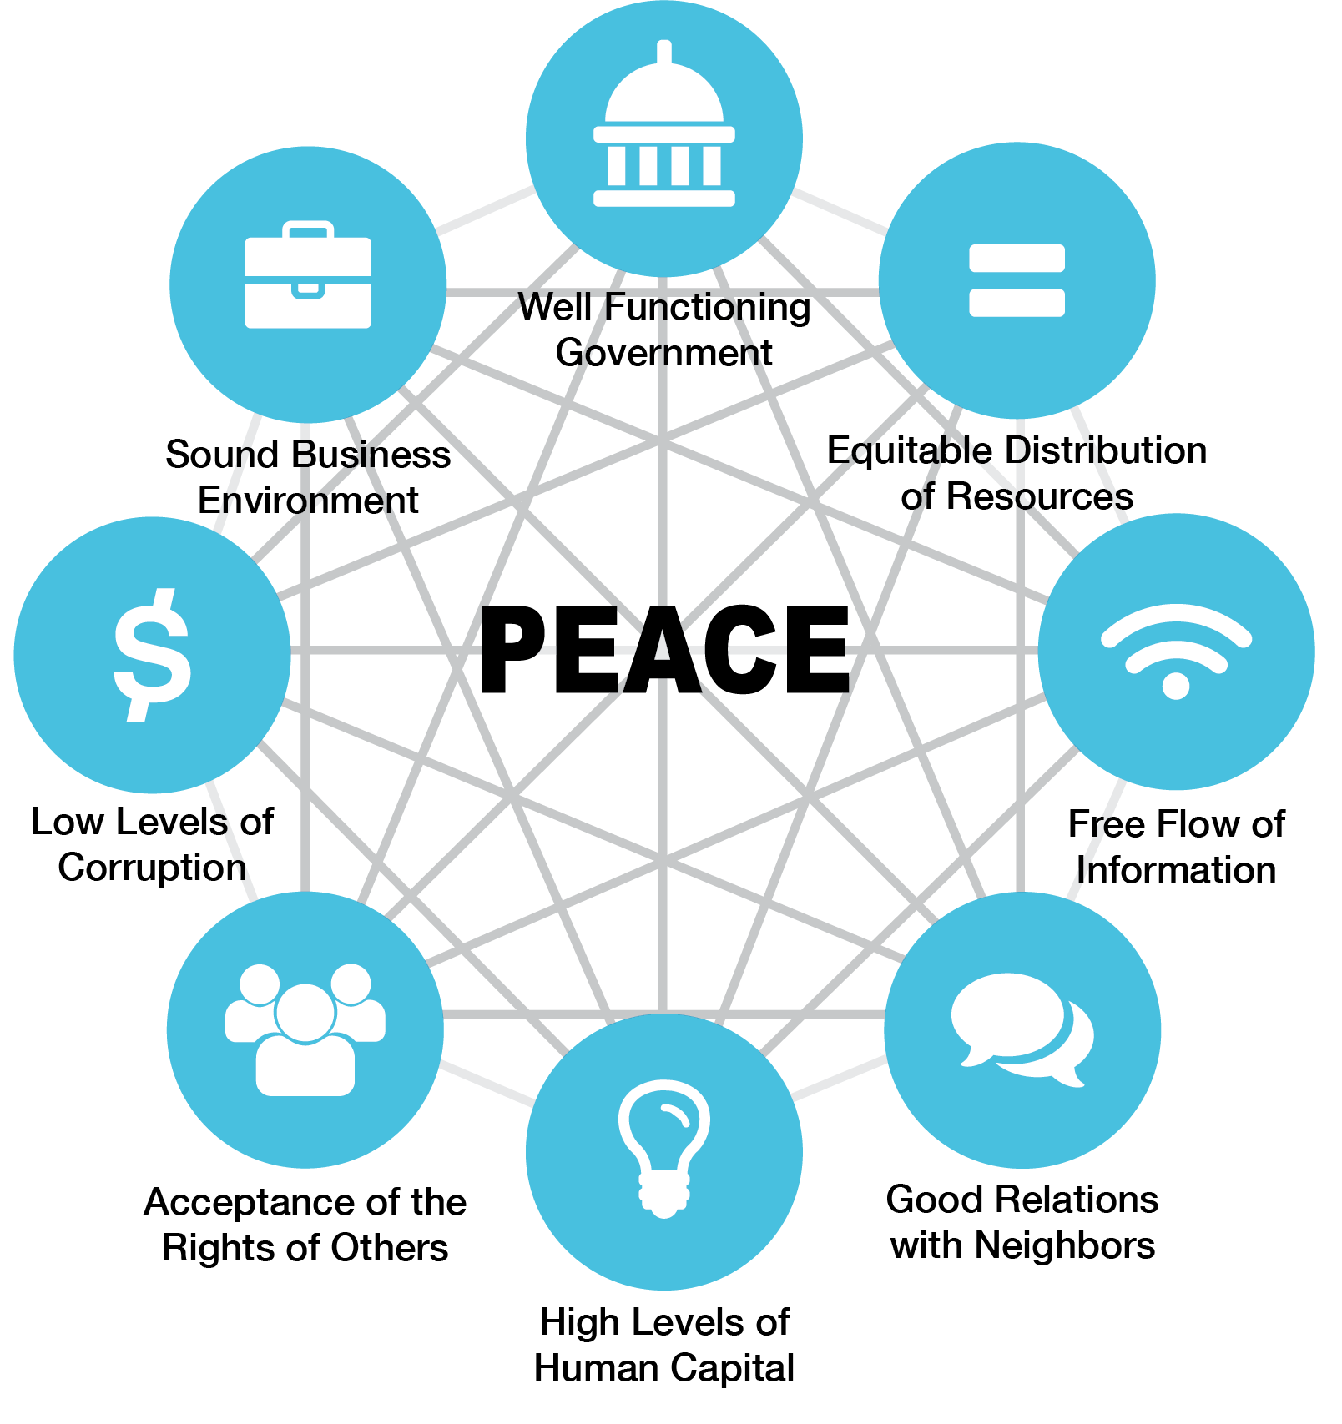
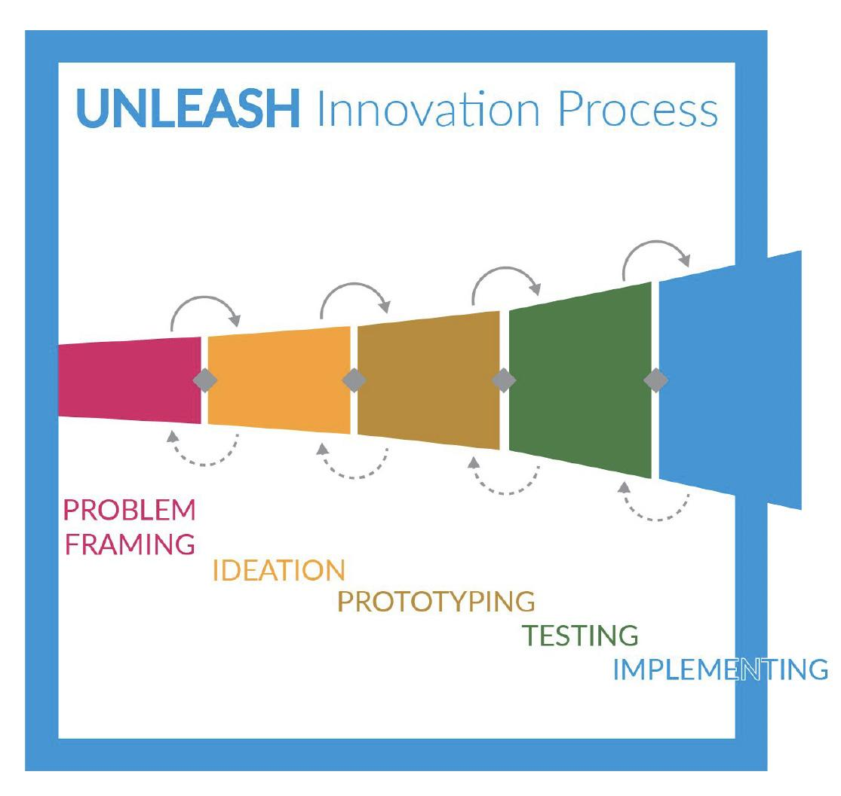
Established Peace Frameworks
Doing
3
4

Slide 8
MAST Academy
Sustainability in Action
Florida’s 1st Gold Apple School

Slide 9
youthpeaceaction.org
Or text YPA to Pat at 305-216-2752

Slide 10
Url: https://youtu.be/ISz1SNKQJjs

