Slide 1
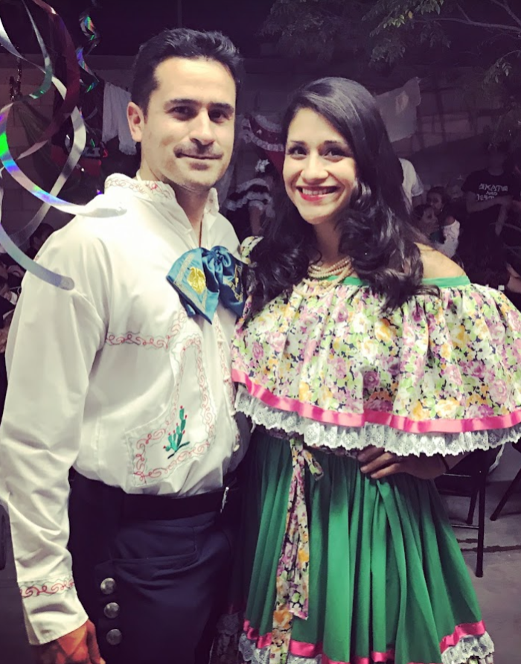
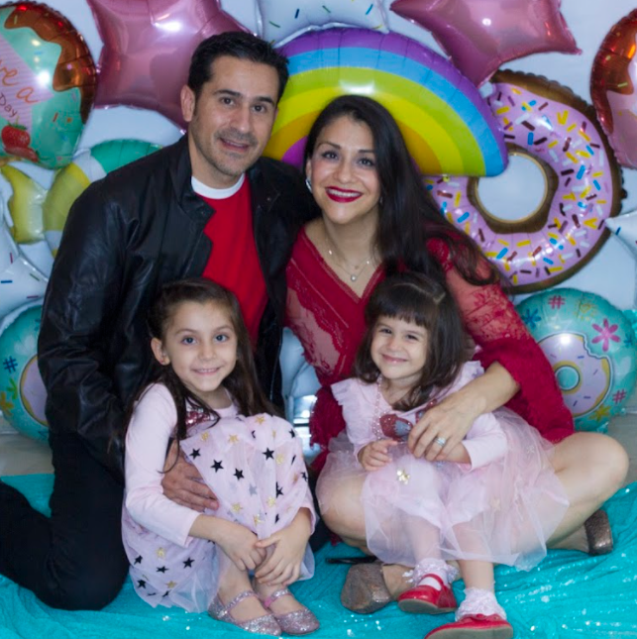
Graciela Robles –
Finance Manager SigniFi Program
About me:
Originally from Mexico.
Located in Miami, FL.
Family first.
Runner.
Dragon boat rower.
Bench jeweler – as a family tradition.
Wise Wealth Finance Solutions LLC. – Personal Finance services.
Education:
BBA – Accounting – Tecnologico of Monterrey- Mexico
International Finance – Ecole Superiore du Commerce - France
MBA Finance – UTEP - Texas
CMA - Florida

Slide 2
Career Path
JnJ SigniFi Program – 2022-2023
GPO Squad Member that serves as the lead in generation of the Detailed Design execution and outputs. Financial systems design
Cerenovus – 6yr.
Mentoring program
Guest Auditor Program PR
Cost Revision for CSS including CIPs, router optimizations, yield and scrap factors, calculation for OVH and Labor rates. Standardize Abs Vs. Non-Abs.
Business Plan, Hedging, Inventory, Cost Accounting – Alterix and Power Bi reporting
Acquisitions, Divestitures. Pulsar-Neuravi
ERP Implementation- JDE.
Chen Med - 2 yr.
Senior Accountant
Create and performs internal controls for AP, Payroll and P card.
Financial records for 42 medical Centers
BVAs
Analyze and record Revenue and COGS base in MRA rates.
Capital Lease amortization
Cardinal Health – 8 yr.
Manufacturing Variance
FDA hold Experience- 1yr.
Managed cost Roll and Financial Plan.
Costing system Maintenance for Mx, DR, Singapore and El Paso Mfg. Sites.
Improvements on Expired components.
Reduce PLT from 120 to 22 days
Lead Kaizen project for cases not scanned
Cordis de Mexico 3 yr.
Financial Analyst
CIPs and Product transfers, Adquisitions, Mexican Tax Compliance
Deloitte.- 3yr.
Audit Consultant.
Automotive companies, General Electric, Electrolux

